Slide 1
OSS bird's-eye view and activities
May 18, 2023
Japan OSS Promotion Forum bird's-eye view WG
Taishi Yoneshima

Slide 2

Introducing yourself
Name: Taishi Yonejima
Affiliation: Bird's-eye view WG, Japan OSS Promotion Forum OSS Promotion Center, NEC Service Technology Development Control Division
Responsible for: Promoting the use of OSS for the NEC Group
Participating OSS communities: ・Japan OSS Promotion Forum Bird's-eye view WG/Steering Committee ・OpenChain JapanWG
Year | Business
Until FY 2016 | OSS verification for BigData and Cloud systems
FY 2017 onward | Support for in-house OSS utilization Participation in the OSS user community
FY 2018 and beyond | +OSS risk verification
FY 2019 onward | +OpenChain JapanWG

Slide 3
TOC
Table of Contents
0. Introduction to self + introduction to organization
OSS bird's-eye view and background of creation
OSS tide seen from OSS bird's-eye view transition
How to find and research OSS

Slide 4

Japan OSS Promotion Forum
History of establishment
2003
The Northeast Asia OSS Promotion Forum was established with the participation of national OSS promotion organizations and government officials.
2004
The Japan OSS Promotion Forum was established with the participation of information system users, vendors, and academic experts in Japan, with the Ministry of Economy, Trade and Industry as an observer.
2014
A bottom-up organization centered on practitioners. As an observer, the Ministry of Economy, Trade and Industry continues to support the Forum.
*General members: 116 companies, regular members: 11 companies, special members: 7 organizations
Japan OSS Promotion Forum. http://ossforum.jp/

Slide 5
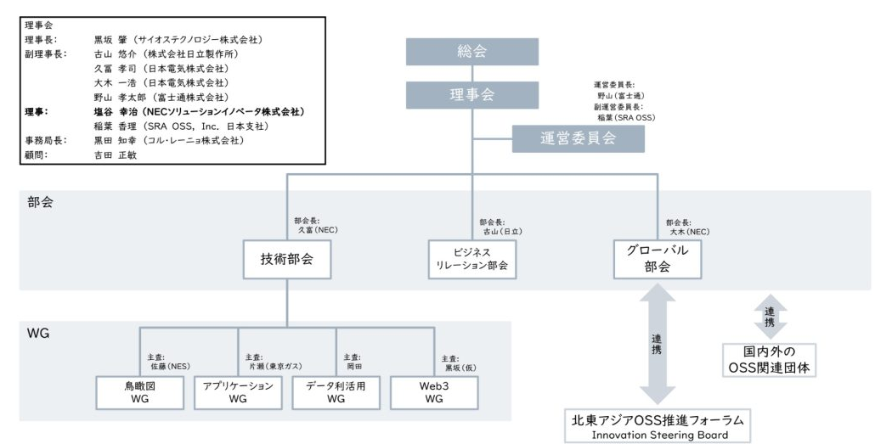
Bird's-eye view WG

Slide 6
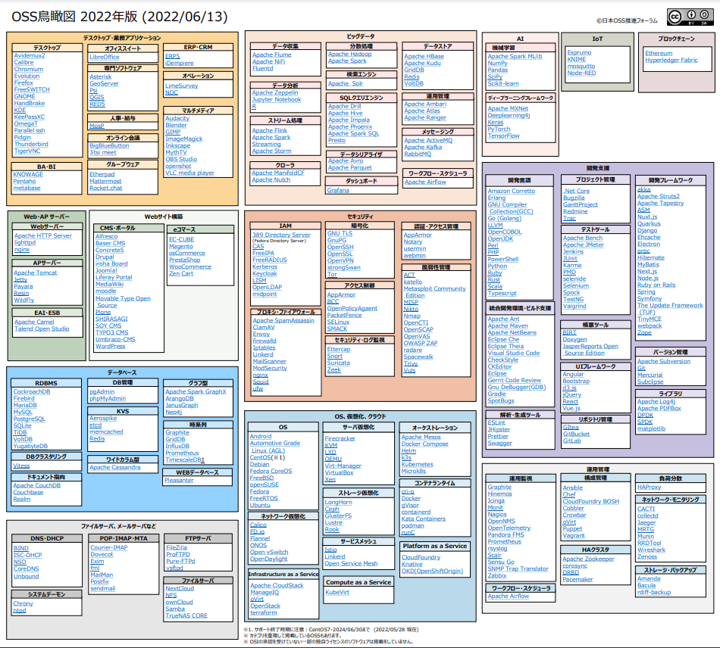
Bird's-eye view WG
Activities
Gather a bird's-eye view of OSS, or related technology trends, and provide information to those using OSS
What is an OSS bird's-eye view?
A visual bird's-eye view of the complex variety of OSS to help OSS novices
Introduced in a document issued by the Ministry of Economy, Trade and Industry
"Case Studies on the Use of OSS and Management Methods for Ensuring Its Security" released by the Ministry of Economy, Trade and Industry
Posted as an effective diagram to visually recognize the spread of OSS https://www.meti.go.jp/press/2021/04/20210421001/20210421001.html
Katase (Tokyo Gas i-net)
To download the PDF version, click here.
Bird's-eye view working group. http://ossforum.jp/node/1332
6

Slide 7
OSS bird's-eye view WG system
Company name/Group name (in no particular order) | Name (Abbreviated titles, in no particular order) | Remarks
Toshiba Digital Solutions | Takashi Okayama
Toshiba Digital Solutions | Masayoshi Kurita
AR Advanced Technology | Hideto Yoshida
Sumitomo Electric | Shusaku Ogama
NEC | Daishi Yoneshima | Activity Leader
Fujitsu | Ryota Noguchi
Fujitsu | Yoshihiro Yasuda
OKI Software | Masami Mori
NEC Solution Innovator | Shohei Nomura
NEC Solutions Innovator | Keiichi Nakamura | Chief Inspector
NEC Solution Innovator | Kenji Sato
Sciosteology | Tsukasa Sato
LibreOffice Japanese Team | Shinji Enoki
HTK Engineering | Go Yamada

Slide 8
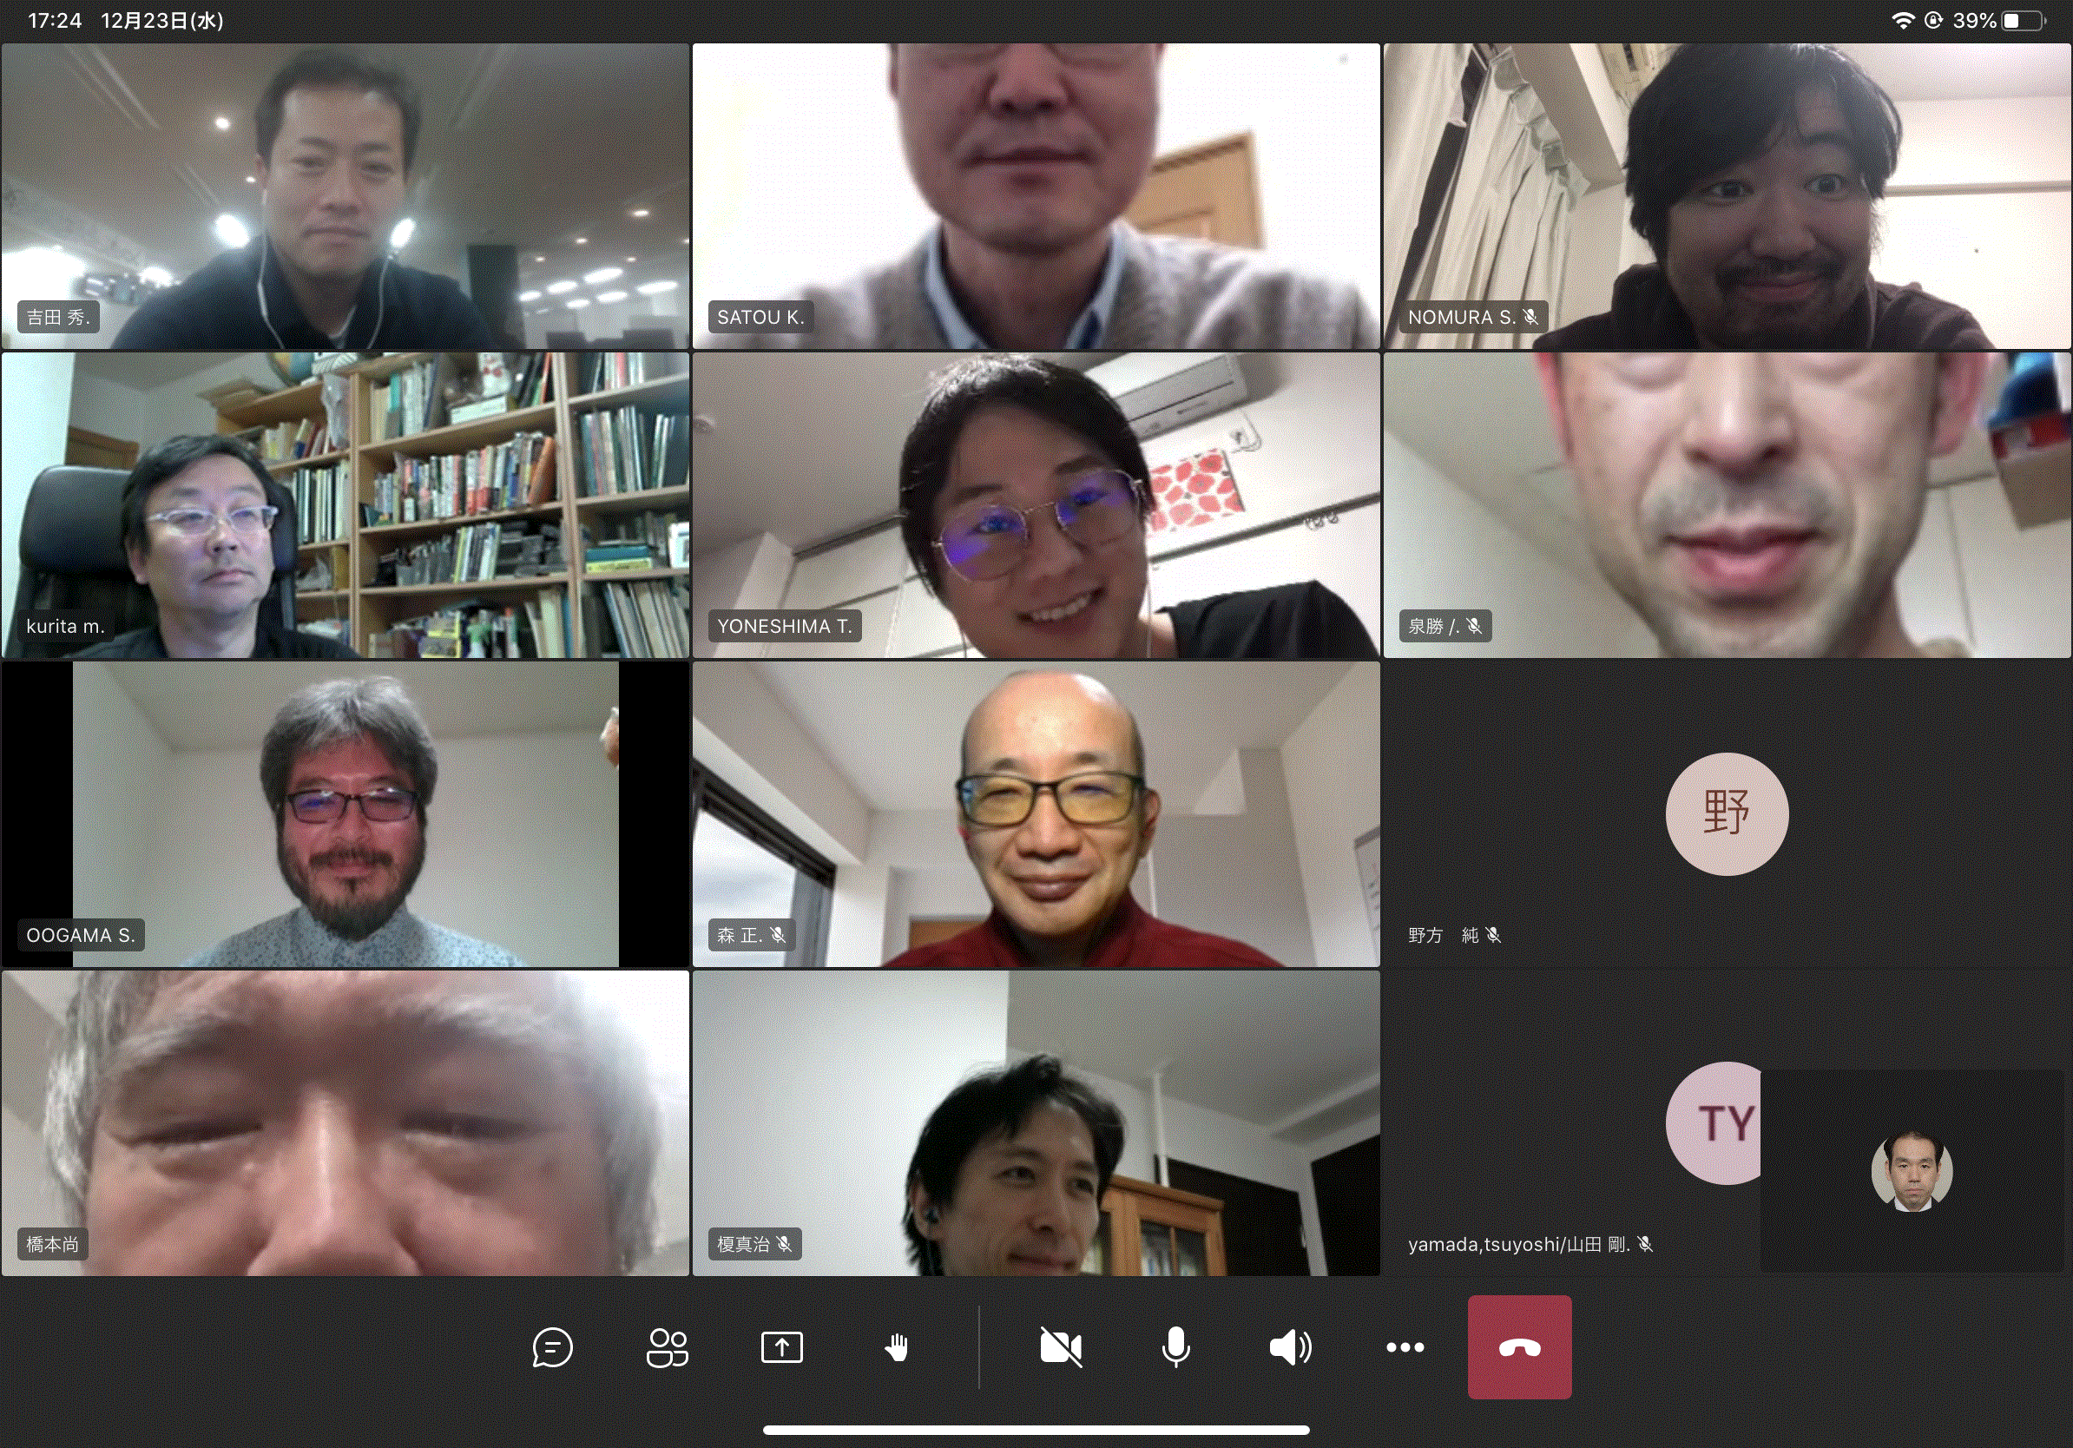
OSS bird's-eye view WG activity

Slide 9
OSS bird's-eye view
Notes:
It takes about 10 minutes to get here.

Slide 10
Before we get to the point ...
Q. How many OSS are there out there?
~1,000 ② 1,000 - ③ 10,000 - ④ 100,000 - ⑤ 1 million -
A. ④ or (5)
・Number of repositories on Github: 200 million
・Number of projects on Open Hub: 499,580
・Number of projects on SourceForge: 112,190
Github. https://github.blog/jp/2021-03-19-improving-large-monorepo-performance-on-github/ (2021.3)
Synopsys BlackDuck OpenHub. https://www.openhub.net/ (2023.5)
SourceForge.net. https://sourceforge.net/ (2023.5)

Slide 11
1. OSS bird's-eye view and background

Slide 12
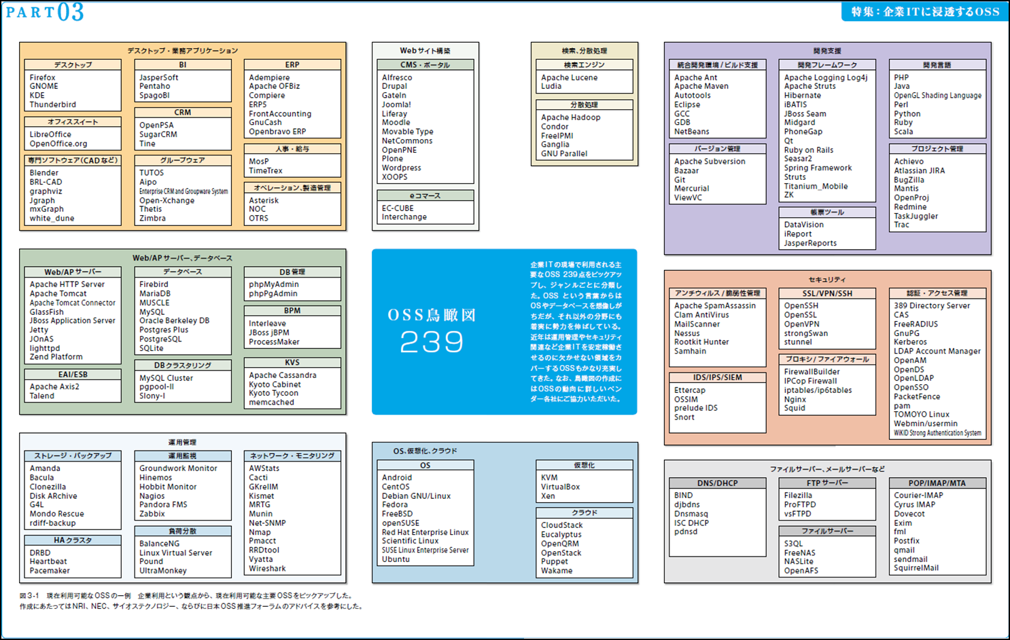

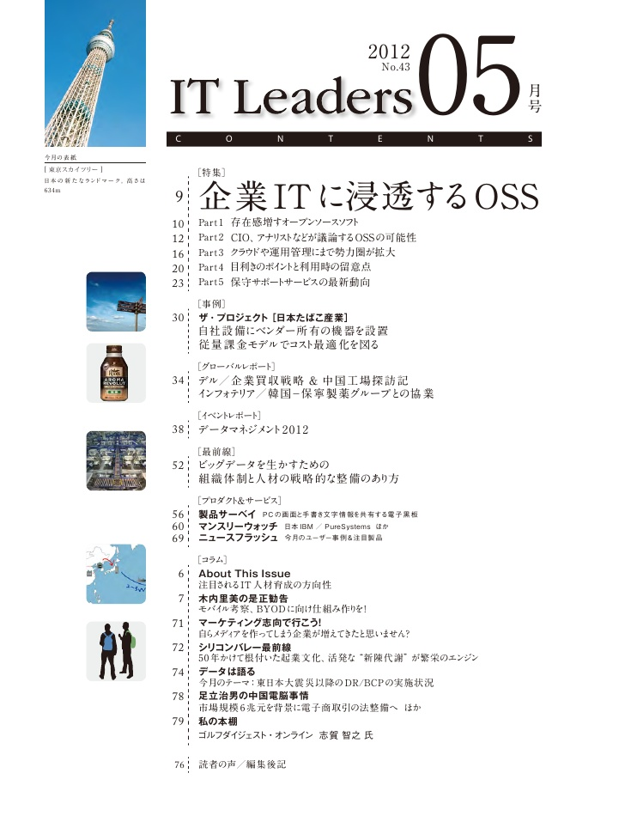
The beginning of the OSS bird's-eye view
May 2012
'OSS bird's-eye view' unveiled at IT Leaders http://it.impressbm.co.jp/articles/-/10007
The intention is to provide a bird's-eye view of OSS in various fields

Slide 13
OSS bird's-eye view goes to Japan OSS Promotion Forum
OSS is evolving so fast that new software is springing up
The cloud technology subcommittee of the Japan OSS Promotion Forum is working to renew the OSS bird's-eye view
It has been updated every year since 2014
From a 2017 ITLeaders article *
It goes without saying that open source software (OSS) is useful for building any kind of information system. However, it is still a high threshold for people and companies who have never used it much, let alone professional engineers skilled in OSS. This is because, depending on the OSS chosen, it can be a trouble-ridden system.
The cloud technology subcommittee of the Japan OSS Promotion Forum, which is in a position to promote OSS, thought of creating an easy-to-understand document that would serve as a reference for utilizing OSS. After consideration, we decided to update the OSS bird's-eye view of IT Leaders that almost all members knew about. With permission from the IT Leaders editorial department, we immediately set to work on the update as the Cloud Technology Task Force.
*(Excerpted from the 2017 edition of IT Leaders 2017/2/15 OSS (Open Source Software) bird's-eye view, Part 1)

Slide 14
The aim of OSS bird's-eye view
Basic Policy
Provides information to guide OSS users in adopting and implementing OSS in their systems.
Updates the OSS bird's-eye view to the latest version to help make OSS selection more secure and quick.
Collects a wide range of advanced technical information on OSS, the latest trends, and case studies in Japan to provide positive information to those who use OSS in various ways.
Frequently used OSS
Peace of mind
Safety
Stable

Slide 15
OSS bird's-eye view

Slide 16
OSS bird's-eye view
Update by Year, not Year
(since 2017)
Creative Commons License
CC BY-SA (View - Inheritance)
Secondary use for commercial purposes also permitted
Category
Subcategory
OSS
Category > Subcategory >OSS
Example)Database >RDBMS>MySQL

Slide 17
2. OSS Trends from the OSS Bird's Eye View
Review the OSS trends by looking at how the OSS bird's eye view has changed from 2014, when the revised version of the OSS bird's eye view began, to the most recent 2022.

Slide 18
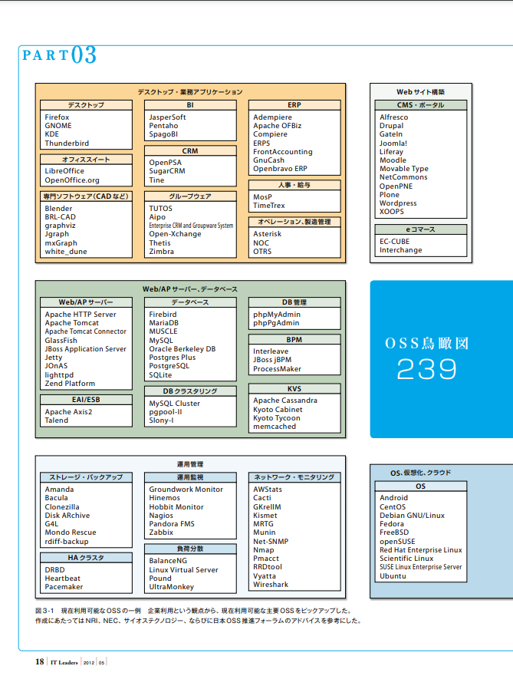
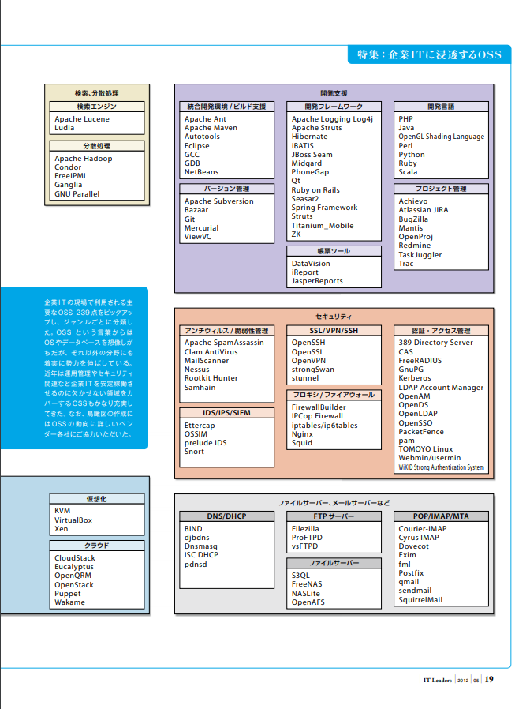
OSS bird view

Slide 19
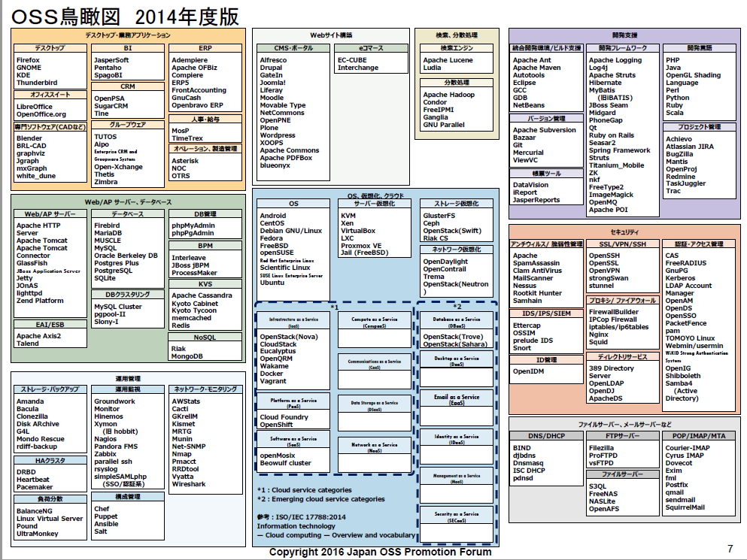

Slide 20
① Add Virtualization &OSS
*Add storage virtualization, network virtualization from server virtualization only
② Detail cloud services & add OSS *Categorization by ISO/IEC 17788

Slide 21
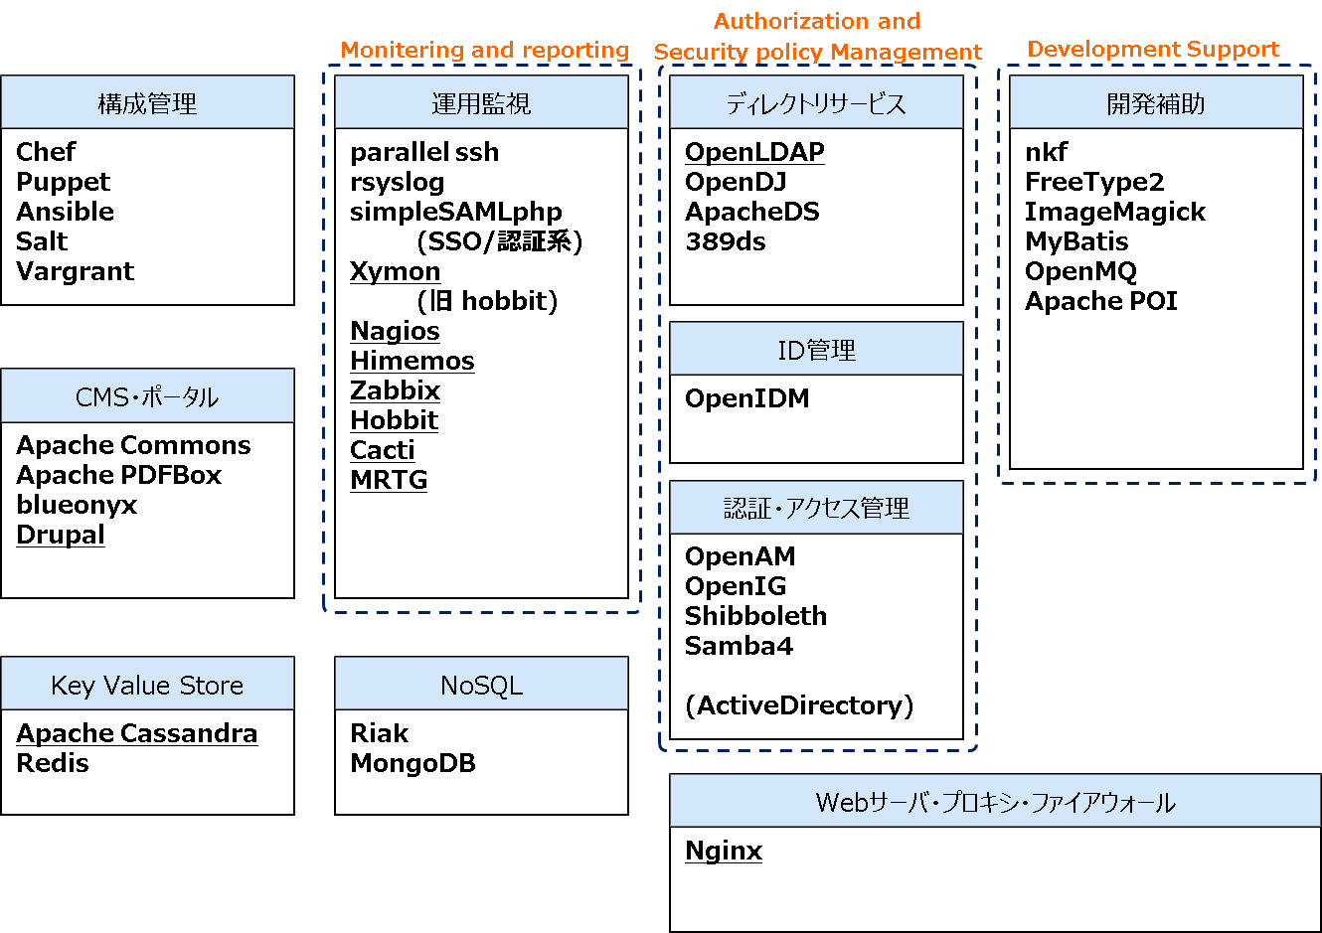
OSS bird's-eye view for 2012 to 2014
③ Other additions and changes
OSS count
2012: 239
2014: 272(+33)
Looking back on 2014 Points:
A number of now common OSS have been added

Slide 22
OSS bird's-eye view 2015
© Impress IT Leaders, Japan OSS Promotion Forum
Desktop business applications
BigData
Search, distributed processing
Desktop
BI
CRM
distributed processing infrastructure
KVS
BA/BI
Search Engine
distributed processing
Adium
Chromium
Firefox
Evolution
KDE
Kopete
Open Manager
Pidgin
RealVNC
Sylpheed
Thunderbird
SpagoBI
OpenPSA
SugarCRM
Hadoop MapReduce
Hadoop YARN
Apache Tez
Apache Mesos
Apache Spark
Apache Oozie
infinispan
Apache Cassandra*
Redis
Riak*
Apache HBase
Pentaho
Pentaho DI
Pentaho Reporting
Apache Lucene
Elasticsearch
Kibana
Apache Hadoop
Apache Sqoop
Apache Storm
Ganglia
office suite
ERP
Apache OpenOffice
LibreOffice
ADempiere
Compiere
ERP5
Openbravo
crawler
quasi-real-time queries
Development assistance
Apache Nutch
Apache ManifoldCF
Apache Drill
Apache Hive
Impara
Apache SparkSQL
In-Memory DB
Integrated Development Environment/Build Assistance
Development Framework
Project management
Personnel and Salary
VoltDB*
Apache Ant
Apache Maven
Cobertura
Eclipse
NetBeans
Ruby on Rails
Gerrit Code Review
Apache ActiveMQ
Apache S4
Apache Struts
Dojo Toolkit
Eclipse TPTP
Ehcache
EMMA
Hibernate
JBoss Seam
Jetspeed
jQuery
MyBatis
Seasar2
Spring
YUI (Yahoo UI Library)
Zope
Bugzilla
mantis
OpenProj
Redmine
Trac
Professional software (such as CAD)
Groupware
MosP
Data Collection
document-oriented DB
Blender
osCommerce
Quantum GIS
SAS
WEKA
Aipo
eGroupware
Thetis
TUTOS
Zimbra
operations, manufacturing control
Apache Sqoop*
Apache Flume
Fluentd
Apache kafka
CEP
MongoDB*
Asterisk
FreeSWITCH
OTRS
Apache Storm*
Apache S4*
Jubatus
Esper*
Drools Fusion ApacheSparkStreaming
ETL
Test Tools
Talend*
Version Control
JMeter
bonnie
FindBugs
JUnit
openSTA
PasTmon
Selenium
TestNG
Valgrind
WebLOAD Open Source
Gdb
Jenkins
Data Storage /
Distributed File System
Apache Subversion
Bazaar
CVS
Git
Mercurial
Web/AP servers, databases
Hadoop HDFS
Lustre*
GlusterFS*
Ceph*
Web/AP Server
Database
DB management
Data Analysis
Apache Bench
Apache HTTP Server
Apache Tomcat
Appweb
GlassFish
Jetty
lighttpd
TUX Web Server
WildFly
Apache Derby
Firebird
MariaDB
MySQL
PostgreSQL
SQLite
phpMyAdmin
phpPgAdmin
R
Mlib
development language
gcc
OpenJDK
Perl
PHP
Python
Ruby
Scala
BPM
OS, virtualization, cloud
JBoss jBPM
OS
Storage virtualization
KVS
Android
CentOS
Debian
Fedora
FreeBSD
OpenSUSE
Scientific Linux
Ubuntu
CoreOS
Server virtualization
Ceph
GlusterFS
Lustre
Document Tools
Apache Cassandra
Apache CouchDB
KVM
OpenNebula
Virt-Manager
VirtualBox
Xen
Docker
iReport Open Source Edition
JasperReports Open Source Edition
EAI/ESB
DB clustering
Network virtualization
Security
Apache Axis2
Apache ServiceMIX
Talend
Talend Open Studio
Esper
NoSQL
OpenDaylight
Trema
OF-patch
memcached
MongoDB
Riak
VoltDB
Antivirus/vulnerability management
SSL/VPN/SSH
Authentication and access management
Apache SpamAssasin
ClamAV
Nessus
swatch
OpenSSH
OpenSSL
OpenVPN
Tor
CAS
FreeRADIUS
GnuPG
Kerberos
OpenAM
OpenDS
OpenSSO
PAM
TOMOYO Linux
usermin
webmin
*1
*2
Infrastructure as a Service (IaaS)
Compute as a Service
(CompaaS)
Database as a Service (DBaaS)
Operations management
Web site construction
Apache CloudStack
Eucalyptus
openQRM
Vagrant
OpenStack Ironic
OpenStack Magnum
OpenStack Nova
OpenStack Glance
Directory Services
Proxy/Firewall
Storage Backup
Operational monitoring
CMS Portal
Desktop as a Service (DaaS)
389 Directory Server
(Fedora Directory Server)
Apache Directory
OpenLDAP
IPCop Firewall
iptables
nginx
Squid
Amanda
Bacula
Clonezilla
Mondo Rescue
Groundwork
Hinemos
Monit
Nagios
OpenNMS
Syslog NG
Zabbix
GNetWatch
Alfresco
Apache Lenya
DotNetNuke
Drupal
eZ Publish
GateIn
Geeklog
Joomla!
Liferay Portal
moodle
Movable Type Open Source
NetCommons
OpenPNE
Plone
PukiWiki
TextPattern
WordPress
Xoops
XOOPS cube
Communications as a Service (CaaS)
IDS/IPS/SIEM
Identity Management
Configuration Management
Platform as a Service (PaaS)
Data Storage as a Service
(DSaaS)
Email as a Service (EaaS)
preludeIDS
Snort
Ansible
Chef
oVirt
Puppet
CloudFoundry
Deltacloud
OpenShift
OpenStack Swift
OpenStack Cinder
OpenStack Manila
File servers, mail servers, etc.
Network Monitoring
Software as a Service (SaaS)
Network as a Service (NaaS)
Identity as a Service (IDaaS)
DNS/DHCP
FTP Server
POP/IMAP/MTA
HA Cluster
CACTI
collectd
MRTG
Munin
NetHogs
RRDTool
Vyatta Core Software
Wireshark
Zenoss
IPTraf
OpenStack Murano
OpenStack Neutron
OpenStack Designate
OpenStack Keystone
BIND
djbdns
ISC-DHCP
NSD
Unbound
FileZilla (JP)
ProFTPD
Pure-FTPd
vsftpd
WU-FTPD
Courier-IMAP
Courier-MTA
Cyrus IMAP
Dovecot
Exim
fml
Postfix (JP)
qmail
qpopper
sendmail
SquirrelMail
XMail
DRBD
Heartbeat
Pacemaker
*1:Cloud service categories
*2:Emerging cloud service categories
Reference: ISO/IEC 17788:2014
Information technology
-- Cloud computing -- Overview and vocabulary
Management as a Service (MaaS)
Load Balancing
File Server
Linux Virtual Server
Pound
Ultra Monkey
Security as a Service (SECaaS)
FreeNAS
NFS
Samba (JP)
OwnCloud
E-Commerce
Shadow characters: Frequently used results of the Cloud Technology Subcommittee
Oblique + green *: Overlap with Bigdata in other categories
EC-Cube
Zen Cart

Slide 23
OSS bird's-eye view 2015
© Impress IT Leaders, Japan OSS Promotion Forum
Desktop business applications
BigData
Search, distributed processing
Desktop
BI
CRM
distributed processing infrastructure
KVS
BA/BI
Search Engine
distributed processing
Adium
Chromium
Firefox
Evolution
KDE
Kopete
Open Manager
Pidgin
RealVNC
Sylpheed
Thunderbird
SpagoBI
OpenPSA
SugarCRM
Hadoop MapReduce
Hadoop YARN
Apache Tez
Apache Mesos
Apache Spark
Apache Oozie
infinispan
Apache Cassandra*
Redis
Riak*
Apache HBase
Pentaho
Pentaho DI
Pentaho Reporting
Apache Lucene
Elasticsearch
Kibana
Apache Hadoop
Apache Sqoop
Apache Storm
Ganglia
office suite
ERP
Apache OpenOffice
LibreOffice
ADempiere
Compiere
ERP5
Openbravo
① New BigData category
crawler
quasi-real-time queries
Development assistance
Apache Nutch
Apache ManifoldCF
Apache Drill
Apache Hive
Impara
Apache SparkSQL
In-Memory DB
Integrated Development Environment/Build Assistance
Development Framework
Project management
Personnel and Salary
VoltDB*
Apache Ant
Apache Maven
Cobertura
Eclipse
NetBeans
Ruby on Rails
Gerrit Code Review
Apache ActiveMQ
Apache S4
Apache Struts
Dojo Toolkit
Eclipse TPTP
Ehcache
EMMA
Hibernate
JBoss Seam
Jetspeed
jQuery
MyBatis
Seasar2
Spring
YUI (Yahoo UI Library)
Zope
Bugzilla
mantis
OpenProj
Redmine
Trac
Professional software (such as CAD)
Groupware
MosP
Data Collection
document-oriented DB
Blender
osCommerce
Quantum GIS
SAS
WEKA
Aipo
eGroupware
Thetis
TUTOS
Zimbra
operations, manufacturing control
Apache Sqoop*
Apache Flume
Fluentd
Apache kafka
CEP
MongoDB*
Asterisk
FreeSWITCH
OTRS
Apache Storm*
Apache S4*
Jubatus
Esper*
Drools Fusion ApacheSparkStreaming
ETL
Test Tools
Talend*
Version Control
JMeter
bonnie
FindBugs
JUnit
openSTA
PasTmon
Selenium
TestNG
Valgrind
WebLOAD Open Source
Gdb
Jenkins
Data Storage /
Distributed File System
Apache Subversion
Bazaar
CVS
Git
Mercurial
Web/AP servers, databases
Hadoop HDFS
Lustre*
GlusterFS*
Ceph*
Web/AP Server
Database
DB management
Data Analysis
Apache Bench
Apache HTTP Server
Apache Tomcat
Appweb
GlassFish
Jetty
lighttpd
TUX Web Server
WildFly
Apache Derby
Firebird
MariaDB
MySQL
PostgreSQL
SQLite
phpMyAdmin
phpPgAdmin
R
Mlib
development language
gcc
OpenJDK
Perl
PHP
Python
Ruby
Scala
BPM
OS, virtualization, cloud
JBoss jBPM
OS
Storage virtualization
KVS
Android
CentOS
Debian
Fedora
FreeBSD
OpenSUSE
Scientific Linux
Ubuntu
CoreOS
Server virtualization
Ceph
GlusterFS
Lustre
Document Tools
② Maintenance of cloud services
*OpenStack, CloudStack, CloudFoundry, Openshift, etc.
iReport Open Source Edition
JasperReports Open Source Edition
Apache Cassandra
Apache CouchDB
KVM
OpenNebula
Virt-Manager
VirtualBox
Xen
Docker
③ Development assistance updates
*Added test tools subcategory
EAI/ESB
DB clustering
Network virtualization
Security
Apache Axis2
Apache ServiceMIX
Talend
Talend Open Studio
Esper
NoSQL
OpenDaylight
Trema
OF-patch
memcached
MongoDB
Riak
VoltDB
Antivirus/vulnerability management
SSL/VPN/SSH
Authentication and access management
Apache SpamAssasin
ClamAV
Nessus
swatch
OpenSSH
OpenSSL
OpenVPN
Tor
CAS
FreeRADIUS
GnuPG
Kerberos
OpenAM
OpenDS
OpenSSO
PAM
TOMOYO Linux
usermin
webmin
*1
*2
Infrastructure as a Service (IaaS)
Compute as a Service
(CompaaS)
Database as a Service (DBaaS)
Operations management
Web site construction
Apache CloudStack
Eucalyptus
openQRM
Vagrant
OpenStack Ironic
OpenStack Magnum
OpenStack Nova
OpenStack Glance
Directory Services
Proxy/Firewall
Storage Backup
Operational monitoring
CMS Portal
Desktop as a Service (DaaS)
389 Directory Server
(Fedora Directory Server)
Apache Directory
OpenLDAP
IPCop Firewall
iptables
nginx
Squid
Amanda
Bacula
Clonezilla
Mondo Rescue
Groundwork
Hinemos
Monit
Nagios
OpenNMS
Syslog NG
Zabbix
GNetWatch
Alfresco
Apache Lenya
DotNetNuke
Drupal
eZ Publish
GateIn
Geeklog
Joomla!
Liferay Portal
moodle
Movable Type Open Source
NetCommons
OpenPNE
Plone
PukiWiki
TextPattern
WordPress
Xoops
XOOPS cube
Communications as a Service (CaaS)
IDS/IPS/SIEM
Identity Management
Configuration Management
Platform as a Service (PaaS)
Data Storage as a Service
(DSaaS)
Email as a Service (EaaS)
preludeIDS
Snort
Ansible
Chef
oVirt
Puppet
CloudFoundry
Deltacloud
OpenShift
OpenStack Swift
OpenStack Cinder
OpenStack Manila
File servers, mail servers, etc.
Network Monitoring
Software as a Service (SaaS)
Network as a Service (NaaS)
Identity as a Service (IDaaS)
DNS/DHCP
FTP Server
POP/IMAP/MTA
HA Cluster
CACTI
collectd
MRTG
Munin
NetHogs
RRDTool
Vyatta Core Software
Wireshark
Zenoss
IPTraf
OpenStack Murano
OpenStack Neutron
OpenStack Designate
OpenStack Keystone
BIND
djbdns
ISC-DHCP
NSD
Unbound
FileZilla (JP)
ProFTPD
Pure-FTPd
vsftpd
WU-FTPD
Courier-IMAP
Courier-MTA
Cyrus IMAP
Dovecot
Exim
fml
Postfix (JP)
qmail
qpopper
sendmail
SquirrelMail
XMail
DRBD
Heartbeat
Pacemaker
*1:Cloud service categories
*2:Emerging cloud service categories
Reference: ISO/IEC 17788:2014
Information technology
-- Cloud computing -- Overview and vocabulary
Management as a Service (MaaS)
Load Balancing
File Server
Linux Virtual Server
Pound
Ultra Monkey
Security as a Service (SECaaS)
FreeNAS
NFS
Samba (JP)
OwnCloud
E-Commerce
Shadow characters: Frequently used results of the Cloud Technology Subcommittee
Oblique + green *: Overlap with Bigdata in other categories
EC-Cube
Zen Cart

Slide 24
OSS bird's-eye view 2017
© Impress IT Leaders, Japan OSS Promotion Forum
Desktop business applications
BigData
Search, distributed processing
Desktop
BI
CRM
distributed processing infrastructure
Machine Learning
BA/BI
search engine
Chromium
Firefox
Evolution
KDE
Kopete
Open Manager
Pidgin
RealVNC
Sylpheed
Thunderbird
Pentaho
SpagoBI
OpenPSA
SugarCRM
Apache Hadoop MapReduce
Apache Hadoop YARN
Apache Mesos
Apache Spark*
Apache Tez
Hivemall
Jubatus
Mlib
Apache Lucene Apache ManifoldCF
Apache Nutch
Elasticsearch
Kibana
logstash
distributed processing
Pentaho*
Apache Hadoop
Apache Spark
Apache Sqoop
Apache Storm
Ganglia
office suite
ERP
Deep Learning
Apache OpenOffice
LibreOffice
ADempiere
Compiere
ERP5
Openbravo
Caffe
Chainer
CNTK
Deeplearning4j
DSSTNE
PredictionIO
TensorFlow
Theano
Torch7
In-memory DB/distributed KVS
Crawler
Apache Cassandra*
Apache HBase
infinispan
MongoDB*
Redis
Riak*
VoltDB*
Development assistance
Apache ManifoldCF*
Apache Nutch*
Integrated Development Environment/Build Assistance
Development Framework
Project management
Personnel and Salary
Apache Ant
Apache Maven
Cobertura
Eclipse
Gerrit Code Review
Gitlab
NetBeans
Ruby on Rails
Apache ActiveMQ
Apache Drill
Apache Logging Log4j
Apache S4
Apache Struts
Dojo Toolkit
Eclipse TPTP
Ehcache
EMMA
Hibernate
JBoss Seam
Jetspeed
jQuery
MyBatis
Node.js
Seasar2
Spring
Zope
.net.core
Bugzilla
mantis
OpenProj
Redmine
Trac
specialized software (such as CAD)
Groupware
MosP
Data Collection
Blender
osCommerce
Quantum GIS
SAS
WEKA
Aipo
eGroupware
Zimbra
Operations, Manufacturing Administration
Apache Flume
Apache kafka
Apache Sqoop*
Fluentd
Talend*
Asterisk
OTRS
CEP
Quasi-real-time queries
Apache S4*
Apache SparkStreaming
Apache Storm*
Drools Fusion
Esper*
Jubatus*
Apache Drill*
Apache Hive
Apache SparkSQL
Impala
Test Tools
Data Accumulation /
Distributed File System
Version Control
apache JMeter
bonnie
FindBugs
Gdb
Jenkins
JUnit
PasTmon
Selenium
TestNG
Valgrind
Web/AP servers, databases
Apache Hadoop HDFS
Ceph*
GlusterFS*
Lustre*
Apache Subversion
CVS
Git
Mercurial
Data analysis
Web/AP Server
Database
DB management
R
ab(ApacheBench)
Apache HTTP Server
Apache Tomcat
Appweb
GlassFish
Jetty
lighttpd
WildFly
Apache Derby
Firebird
MariaDB
MySQL
PostgreSQL
SQLite
phpMyAdmin
phpPgAdmin
development language
gcc
OpenJDK
Perl
PHP
PowerShell
Python
Ruby
Scala
typescript
BPM
OS, virtualization, cloud
JBoss jBPM
OS
Storage virtualization
KVS
Android
CentOS
CoreOS
Debian
Fedora
FreeBSD
openSUSE
Scientific Linux
Ubuntu
Server virtualization
Ceph
GlusterFS
Lustre
Document Tools
Apache Cassandra
Docker
KVM
Virt-Manager
VirtualBox
Xen
iReport Open Source Edition
JasperReports Open Source Edition
EAI/ESB
DB clustering
Network virtualization
NoSQL
OF-patch
OpenDaylight
Trema
Security
Apache Axis2
Apache ServiceMIX
Talend
Talend Open Studio
Esper
memcached
MongoDB
Riak
VoltDB
Antivirus/vulnerability management
SSL/VPN/SSH
Authentication and access management
Apache SpamAssasin
ClamAV
openSCAP
openVAS
OWASP ZAP
swatch
OpenSSH
OpenSSL
OpenVPN
Tor
Apparmor
CAS
FreeRADIUS
GnuPG
Kerberos
Keycloak
OpenAM
PAM
SELinux
usermin
webmin
*1
*2
Infrastructure as a Service (IaaS)
Compute as a Service
(CompaaS)
Database as a Service (DBaaS)
Operations management
Web site construction
Eucalyptus
Kubernetes
OpenStack Ironic
OpenStack Magnum
Vagrant
OpenStack Nova
OpenStack Glance
Proxy/Firewall
Storage Backup
Operational monitoring
CMS Portal
Desktop as a Service (DaaS)
iptables
nginx
Squid
Amanda
Bacula
Clonezilla
Mondo Rescue
GNetWatch Groundwork
Hinemos
Monit
Nagios
OpenNMS
Syslog NG
Zabbix
Alfresco
Apache Lenya
DotNetNuke
Drupal
eZ Publish
GateIn
Geeklog
Joomla!
Liferay Portal
moodle
Movable Type Open Source
NetCommons
OpenPNE
Plone
PukiWiki
WordPress
Xoops
XOOPS cube
Communications as a Service (CaaS)
Directory services
389 Directory Server
Apache Directory server
OpenDJ
OpenLDAP
IDS/IPS/SIEM
Configuration Management
Platform as a Service (PaaS)
Data Storage as a Service
(DSaaS)
Email as a Service (EaaS)
Snort
Identity management
Ansible
Chef
oVirt
Puppet
CloudFoundry
Deltacloud
OpenShift
OpenStack Cinder
OpenStack Manila
OpenStack Swift
FreeIPA
OpenIDM
Network Monitoring
Identity as a Service (IDaaS)
File servers, mail servers, etc.
HA Cluster
CACTI
MRTG
Munin
NetHogs
RRDTool
Vyatta Core Software
Wireshark
Zenoss
Software as a Service (SaaS)
Network as a Service (NaaS)
OpenStack Keystone
DNS/DHCP
FTP Server
POP/IMAP/MTA
DRBD
Heartbeat
Pacemaker
OpenStack Murano
OpenStack Neutron
OpenStack Designate
BIND
djbdns
ISC-DHCP
NSD
Unbound
FileZilla (JP)
ProFTPD
vsftpd
WU-FTPD
Courier-IMAP
Courier-MTA
Cyrus IMAP
Dovecot
Exim
fml
Postfix (JP)
qmail
qpopper
sendmail
SquirrelMail
*1:Cloud service categories
*2:Emerging cloud service categories
Reference: ISO/IEC 17788:2014
Information technology
-- Cloud computing -- Overview and vocabulary
Management as a Service (MaaS)
Load Balancing
File Server
Linux Virtual Server
Pound
Ultra Monkey
Security as a Service (SECaaS)
NFS
Samba (JP)
OwnCloud
e-commerce
Shadow characters: Frequently used results of the Cloud Technology Subcommittee
Oblique + green *: Overlap with Bigdata in other categories
EC-Cube

Slide 25
OSS bird's-eye view 2017
© Impress IT Leaders, Japan OSS Promotion Forum
Desktop business applications
BigData
Search, distributed processing
Desktop
BI
CRM
distributed processing infrastructure
Machine Learning
BA/BI
search engine
Chromium
Firefox
Evolution
KDE
Kopete
Open Manager
Pidgin
RealVNC
Sylpheed
Thunderbird
Pentaho
SpagoBI
OpenPSA
SugarCRM
Apache Hadoop MapReduce
Apache Hadoop YARN
Apache Mesos
Apache Spark*
Apache Tez
Hivemall
Jubatus
Mlib
Apache Lucene Apache ManifoldCF
Apache Nutch
Elasticsearch
Kibana
logstash
distributed processing
Pentaho*
Apache Hadoop
Apache Spark
Apache Sqoop
Apache Storm
Ganglia
office suite
ERP
Deep Learning
Apache OpenOffice
LibreOffice
ADempiere
Compiere
ERP5
Openbravo
Caffe
Chainer
CNTK
Deeplearning4j
DSSTNE
PredictionIO
TensorFlow
Theano
Torch7
In-memory DB/distributed KVS
Crawler
Apache Cassandra*
Apache HBase
infinispan
MongoDB*
Redis
Riak*
VoltDB*
Development assistance
Apache ManifoldCF*
Apache Nutch*
Integrated Development Environment/Build Assistance
Development Framework
Project management
Personnel and Salary
Apache Ant
Apache Maven
Cobertura
Eclipse
Gerrit Code Review
Gitlab
NetBeans
Ruby on Rails
Apache ActiveMQ
Apache Drill
Apache Logging Log4j
Apache S4
Apache Struts
Dojo Toolkit
Eclipse TPTP
Ehcache
EMMA
Hibernate
JBoss Seam
Jetspeed
jQuery
MyBatis
Node.js
Seasar2
Spring
Zope
.net.core
Bugzilla
mantis
OpenProj
Redmine
Trac
specialized software (such as CAD)
Groupware
MosP
Data Collection
Blender
osCommerce
Quantum GIS
SAS
WEKA
Aipo
eGroupware
Zimbra
Operations, Manufacturing Administration
Apache Flume
Apache kafka
Apache Sqoop*
Fluentd
Talend*
Asterisk
OTRS
CEP
Quasi-real-time queries
Apache S4*
Apache SparkStreaming
Apache Storm*
Drools Fusion
Esper*
Jubatus*
Apache Drill*
Apache Hive
Apache SparkSQL
Impala
Test Tools
Data Accumulation /
Distributed File System
Version Control
apache JMeter
bonnie
FindBugs
Gdb
Jenkins
JUnit
PasTmon
Selenium
TestNG
Valgrind
Web/AP servers, databases
Apache Hadoop HDFS
Ceph*
GlusterFS*
Lustre*
Apache Subversion
CVS
Git
Mercurial
Data analysis
Web/AP Server
Database
DB management
R
ab(ApacheBench)
Apache HTTP Server
Apache Tomcat
Appweb
GlassFish
Jetty
lighttpd
WildFly
Apache Derby
Firebird
MariaDB
MySQL
PostgreSQL
SQLite
phpMyAdmin
phpPgAdmin
development language
gcc
OpenJDK
Perl
PHP
PowerShell
Python
Ruby
Scala
typescript
BPM
OS, virtualization, cloud
JBoss jBPM
① BigData category update
AI relationship subcategory
Add (machine learning, deep learning)
OS
Storage virtualization
KVS
Android
CentOS
CoreOS
Debian
Fedora
FreeBSD
openSUSE
Scientific Linux
Ubuntu
Server virtualization
Ceph
GlusterFS
Lustre
Document Tools
Apache Cassandra
Docker
KVM
Virt-Manager
VirtualBox
Xen
iReport Open Source Edition
JasperReports Open Source Edition
EAI/ESB
DB clustering
Network virtualization
NoSQL
OF-patch
OpenDaylight
Trema
Security
Apache Axis2
Apache ServiceMIX
Talend
Talend Open Studio
Esper
memcached
MongoDB
Riak
VoltDB
Antivirus/vulnerability management
SSL/VPN/SSH
Authentication and access management
Apache SpamAssasin
ClamAV
openSCAP
openVAS
OWASP ZAP
swatch
OpenSSH
OpenSSL
OpenVPN
Tor
Apparmor
CAS
FreeRADIUS
GnuPG
Kerberos
Keycloak
OpenAM
PAM
SELinux
usermin
webmin
*1
*2
Infrastructure as a Service (IaaS)
Compute as a Service
(CompaaS)
Database as a Service (DBaaS)
Operations management
Web site construction
Eucalyptus
Kubernetes
OpenStack Ironic
OpenStack Magnum
Vagrant
OpenStack Nova
OpenStack Glance
Proxy/Firewall
Storage Backup
Operational monitoring
CMS Portal
Desktop as a Service (DaaS)
iptables
nginx
Squid
Amanda
Bacula
Clonezilla
Mondo Rescue
GNetWatch Groundwork
Hinemos
Monit
Nagios
OpenNMS
Syslog NG
Zabbix
Alfresco
Apache Lenya
DotNetNuke
Drupal
eZ Publish
GateIn
Geeklog
Joomla!
Liferay Portal
moodle
Movable Type Open Source
NetCommons
OpenPNE
Plone
PukiWiki
WordPress
Xoops
XOOPS cube
Communications as a Service (CaaS)
Directory services
389 Directory Server
Apache Directory server
OpenDJ
OpenLDAP
IDS/IPS/SIEM
Configuration Management
Platform as a Service (PaaS)
Data Storage as a Service
(DSaaS)
Email as a Service (EaaS)
Snort
Identity management
Ansible
Chef
oVirt
Puppet
CloudFoundry
Deltacloud
OpenShift
OpenStack Cinder
OpenStack Manila
OpenStack Swift
FreeIPA
OpenIDM
Network Monitoring
Identity as a Service (IDaaS)
File servers, mail servers, etc.
HA Cluster
CACTI
MRTG
Munin
NetHogs
RRDTool
Vyatta Core Software
Wireshark
Zenoss
Software as a Service (SaaS)
Network as a Service (NaaS)
OpenStack Keystone
DNS/DHCP
FTP Server
POP/IMAP/MTA
DRBD
Heartbeat
Pacemaker
OpenStack Murano
OpenStack Neutron
OpenStack Designate
BIND
djbdns
ISC-DHCP
NSD
Unbound
FileZilla (JP)
ProFTPD
vsftpd
WU-FTPD
Courier-IMAP
Courier-MTA
Cyrus IMAP
Dovecot
Exim
fml
Postfix (JP)
qmail
qpopper
sendmail
SquirrelMail
*1:Cloud service categories
*2:Emerging cloud service categories
Reference: ISO/IEC 17788:2014
Information technology
-- Cloud computing -- Overview and vocabulary
Management as a Service (MaaS)
Load Balancing
File Server
Linux Virtual Server
Pound
Ultra Monkey
Security as a Service (SECaaS)
NFS
Samba (JP)
OwnCloud
e-commerce
Shadow characters: Frequently used results of the Cloud Technology Subcommittee
Oblique + green *: Overlap with Bigdata in other categories
EC-Cube

Slide 26
OSS bird's-eye view for 2015 to 2017
New big data category (2015)
Added machine learning category (2017) Added Hivemall, Jubatus MLlib moves from data analysis to machine learning category
Added deep learning category (2017) OSS added: Caffe, Chainer, CNTK, Deeplearning4j, DSSTNE, PredictionIO, TensorFlow, Theano, Torch7 added
Maintenance and integration of cloud service categories
Consolidation of OpenStack, CloudStack, CloudFoundry, etc.
Docker added in 2015, Kubernetes added in 2017
OSS count
2014: 272
2017: 290(+18)
Looking back on 2015 to 2017 Points:
Cloud (virtualization), big data (distributed processing) areas in focus

Slide 27
2015 to 2017 OSS bird's-eye view
OSS removal by generational change
2015:4 Apache Oozie (distributed processing infrastructure), Drools Fusion (CEP), Pentaho DI, Pentaho Reporting(BA/BI)
2017:15 SpagoBI, Thetis, TUTOS (desktop and business applications), Apache CouchDB (Web/AP server, database), Zen Cart (website construction), Apache CloudStack (OS, virtualization, cloud), Bazaar, Apache Drill (development support), Nessus (maintenance of OSS version ended), OpenDS, OpenSSO (now OpenAM), Apache CloudStack, Bazaar, FreeNAS, IPTraf, Zen Cart (missing from survey source data)
Even famous ones can be deleted
Common reasons for deletion
・Development terminated, EoL declared
・Community not functioning (Site closures, stagnant development, etc.)
・Moving to a commercial license
・Moving (forked) to another OSS, absorbed

Slide 28
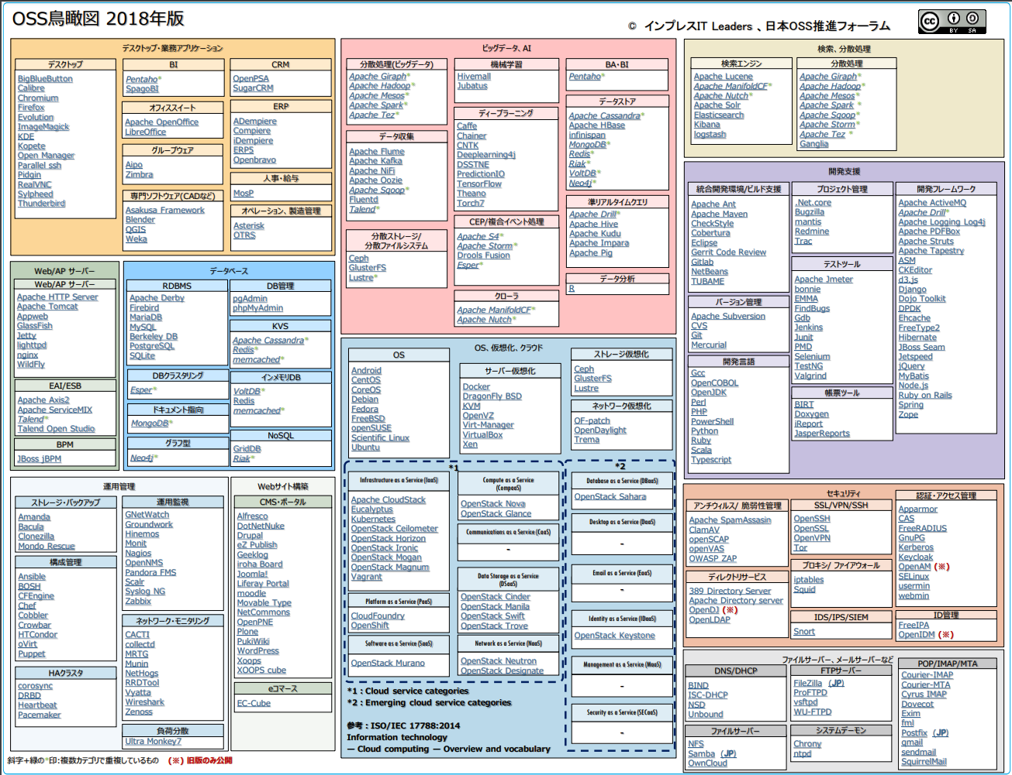

Slide 29
③ Database Independence
② Big Data Update
① Development Support, Operational Management Update
① Development Support, Operational Management Update

Slide 30
OSS bird's-eye view 2019 (2019/4/19)
© Impress IT Leaders, Japan OSS Promotion Forum
Desktop business applications
Big Data
IoT
Blockchain
Desktop
BA/BI
CRM
Data Collection
distributed processing
Data Store
Espruino
KNIME
Node-RED (JP)
BitCoin (JP)
Ethereum
Hyperledger fabric
BigBlueButton
Calibre
Chromium
Evolution
Firefox
Gajim
GIMP
GKrellM
ImageMagick
KDE
Kopete
Open Manager
parallel ssh
Pidgin
RealVNC
Thunderbird
Pentaho
OpenPSA
SugarCRM
Apache Flume
Apache NiFi
Apache Sqoop
Fluentd
Logstash
Talend
Apache Hadoop
Apache Mesos
Apache Spark
Apache Storm
Apache Tez
Apache HBase
Apache Kudu
Infinispan
MongoDB
Redis
VoltDB
GridDB
Groupware
Zimbra
ERP
Development support
Office Suites
Compiere
ERP5
iDempiere
Openbravo
development language
Project management
Development Framework
Apache OpenOffice
LibreOffice
data analysis
Search Engine
Amazon Corretto
Erlang
Gcc
Go(Golang)
OpenCOBOL
OpenJDK
Perl
PHP
PowerShell
Python
Ruby
Scala
typescript
.NET core
Bugzilla
Redmine
Trac
Akka
Angular
Apache Logging Log4j
Apache PDFBox
Apache Struts
Apache Tapestry
ASM
CKEditor
d3.js
Django
DPDK
Ehcache
gRPC
Hibernate
Jetspeed2
jQuery
matplotlib
MyBatis
Node.js
Ruby on Rails
Spring
Vue.js
Zope
Professional software (such as CAD)
Apache Zeppelin
Jupyter Notebook
R
Apache ManifoldCF
Apache Solr
Elasticsearch
Elastic Beats
distributed storage
distributed file system
Asakusa Framework
Audacity
Blender
Dia
e-Commap
QGIS
WEKA
Operations and Manufacturing Management
Ceph
GlusterFS
Lustre
Asterisk
LimeSurvey
OTRS
Test Tools
stream processing
SQL query engine
Apache Jmeter
Bonnie
EMMA
FindBugs
Jenkins
Junit
OpenTracing
PMD
Selenium
TestNG
Valgrind
Personnel and Salary
Apache Flink
Apache S4
Apache Spark Streaming
Apache Storm
Esper
Apache Drill
Apache Hive
Apache Impala
Apache Pig
Apache Phoenix
Apache SparkSQL
Messaging
MosP
Apache ActiveMQ
Apache kafka
NATS
RabbitMQ
Web AP server
Database
Integrated development environment and build support
Web AP server
RDBMS
DB management
Dashboard
Operations management
Apache Bench
Apache HTTP Server
Apache Tomcat
Appweb
GlassFish
Jetty
Lighttpd
nginX
WildFly
Apache Derby
Berkeley DB
Firebird
MariaDB
MySQL
PostgreSQL
SQLite
pgAdmin
phpMyAdmin
Grafana
Kibana
Data Serializer
Apache Ambari
Apache Atlas
Apache Knox
Apache Ranger
Apache Sentry
Ganglia
Apache Ant
Apache Maven
Apache Studio
CheckStyle
Cobertura
Eclipse
ESLint
Gdb
GitBucket
Gitlab
Gradle
Helm
NetBeans
Swagger
TUBAME
Apache Avro
Apache Parquet
KVS
Crawler
Apache Cassandra
Redis
memcached
Apache ManifoldCF
Apache Nutch
Workflow Scheduler
forms tool
Apache Airflow
BIRT
Doxygen
iReport Open Source Edition
JasperReports Open Source Edition
DB clustering
In-Memory DB
AI
EAI/ESB
Esper
Vitess
VoltDB
Redis
memcached
Machine Learning
Deep Learning Framework
Versioning
Apache Axis2
Apache ServiceMIX
Talend
Talend Open Studio
Apache Hivemall
Apache Spark MLlib
CoreML
Jubatus
Apache MXNet
Caffe2
Chainer
CNTK
Neon
PaddlePaddle
PyTorch
TensorFlow
Apache Subversion
CVS
Git
Mercurial
Document oriented
NoSQL
MongoDB
GridDB
Riak
BPM
Graph type
WEB database
JBoss jBPM
JanusGraph
neo4j
Exment
Pleasanter
OS, virtualization, cloud
Security
Antivirus and vulnerability management
SSL/VPN/SSH
Authentication and access management
Operations management
OS
Server virtualization
Storage virtualization
Apache SpamAssasin
ClamAV
Metasploit Community Edition
OpenSCAP
OpenVAS
OWASP ZAP
OpenSSH
OpenSSL
OpenVPN
Tor
CAS
FreeRADIUS
GnuPG
Istio
Kerberos
Keycloak
Notary
SELinux
SMACK
usermin
webmin
Web site construction
AGL
Android
CentOS
CoreOS
Debian
Fedora
FreeBSD
openSUSE
Scientific Linux
Ubuntu
Docker
KVM
OpenVZ
rkt
Virt-Manager
VirtualBox
Xen
Ceph
GlusterFS
Lustre
Rook
Storage Backup
Configuration Management
CMS Portal
Amanda
Bacula
Clonezilla
Ansible
BOSH
CFEngine
Chef
Cobbler
Crowbar
oVirt
Puppet
Alfresco
Drupal
eZ Publish
Geeklog
Iroha board
Joomla!
Liferay Portal
moodle
Movable Type Open Source
NetCommons
OpenPNE
Plone
SHIRASAGI
WordPress
Xoops
XOOPS cube
Proxy Firewall
Network virtualization
iptables
nginx
Squid
Operational monitoring
Open vSwitch
OpenDaylight
Directory Services
GNetWatch
Hinemos
Icinga
Monit
Nagios
OpenNMS
Pandora FMS
Prometheus
rsyslog
Scalr
SNMP Trap Translator
Zabbix
389 Directory Server
OpenLDAP
IDS/IPS/SIEM
Snort
Reverse Engineering
Software as a Service (SaaS)
Compute as a Service
(CompaaS)
Database as a Service (DBaaS)
Identity Management
Patch content management
radare
Network Monitoring
OpenStack Murano
OpenStack Glance
OpenStack Nova
OpenStack Sahara
FreeIPA
kattello
Spacewalk
Network security monitoring
CACTI
Collectd
Jaeger
MRTG
Munin
Nmap
RRDTool
Wireshark
Zenoss
Infrastructure as a Service (IaaS)
Data Storage as a Service(DSaaS)
Bro
Apache CloudStack
Eucalyptus
Kubernetes OpenStack Ceilometer OpenStack Horizon
OpenStack Ironic
OpenStack Mogan
OpenStack Magnum
Vagrant
Rancher
Identity as a Service (IDaaS)
OpenStack Cinder
OpenStack Manila
OpenStack Swift
OpenStack Trove
File servers, mail servers, etc.
OpenStack Keystone
DNS and DHCP
FTP Server
POP/IMAP/MTA
BIND
ISC-DHCP
NSD
Unbound
FileZilla (JP)
Proftpd
vsftpd
WU-FTPD
Courier-IMAP
Courier-MTA
Cyrus IMAP
Dovecot
Exim
fml
Postfix (JP)
qmail
sendmail
HA Cluster
E-commerce
Platform as a Service (PaaS)
Apache Zookeeper
corosync
DRBD
Heartbeat
Pacemaker
EC-CUBE
CloudFoundry
OpenShift
Network as a Service (NaaS)
OpenStack Neutron
OpenStack Designate
File server
Load Balancing
Reference: ISO/IEC 17788:2014
Information technology
-- Cloud computing -- Overview and vocabulary
System Daemon
NextCloud
NFS
OwnCloud
Samba (JP)
HAProxy
Chrony
ntpd
Some OSS lists duplicate categories.

Slide 31
OSS bird's-eye view 2019 (2019/4/19)
© Impress IT Leaders, Japan OSS Promotion Forum
Desktop business applications
Big Data
IoT
Blockchain
Desktop
BA/BI
CRM
Data Collection
distributed processing
Data Store
Espruino
KNIME
Node-RED (JP)
BitCoin (JP)
Ethereum
Hyperledger fabric
BigBlueButton
Calibre
Chromium
Evolution
Firefox
Gajim
GIMP
GKrellM
ImageMagick
KDE
Kopete
Open Manager
parallel ssh
Pidgin
RealVNC
Thunderbird
Pentaho
OpenPSA
SugarCRM
Apache Flume
Apache NiFi
Apache Sqoop
Fluentd
Logstash
Talend
Apache Hadoop
Apache Mesos
Apache Spark
Apache Storm
Apache Tez
Apache HBase
Apache Kudu
Infinispan
MongoDB
Redis
VoltDB
GridDB
Groupware
Zimbra
ERP
Development support
Compiere
ERP5
iDempiere
Openbravo
④ IoT, blockchain additions
Office Suites
development language
Project management
Development Framework
Apache OpenOffice
LibreOffice
data analysis
Search Engine
Amazon Corretto
Erlang
Gcc
Go(Golang)
OpenCOBOL
OpenJDK
Perl
PHP
PowerShell
Python
Ruby
Scala
typescript
.NET core
Bugzilla
Redmine
Trac
Akka
Angular
Apache Logging Log4j
Apache PDFBox
Apache Struts
Apache Tapestry
ASM
CKEditor
d3.js
Django
DPDK
Ehcache
gRPC
Hibernate
Jetspeed2
jQuery
matplotlib
MyBatis
Node.js
Ruby on Rails
Spring
Vue.js
Zope
Professional software (such as CAD)
Apache Zeppelin
Jupyter Notebook
R
Apache ManifoldCF
Apache Solr
Elasticsearch
Elastic Beats
distributed storage
distributed file system
Asakusa Framework
Audacity
Blender
Dia
e-Commap
QGIS
WEKA
Operations and Manufacturing Management
Ceph
GlusterFS
Lustre
Asterisk
LimeSurvey
OTRS
Test Tools
stream processing
SQL query engine
Apache Jmeter
Bonnie
EMMA
FindBugs
Jenkins
Junit
OpenTracing
PMD
Selenium
TestNG
Valgrind
Personnel and Salary
Apache Flink
Apache S4
Apache Spark Streaming
Apache Storm
Esper
Apache Drill
Apache Hive
Apache Impala
Apache Pig
Apache Phoenix
Apache SparkSQL
Messaging
MosP
Apache ActiveMQ
Apache kafka
NATS
RabbitMQ
Web AP server
Database
Integrated development environment and build support
Web AP server
RDBMS
DB management
Dashboard
Operations management
Apache Bench
Apache HTTP Server
Apache Tomcat
Appweb
GlassFish
Jetty
Lighttpd
nginX
WildFly
Apache Derby
Berkeley DB
Firebird
MariaDB
MySQL
PostgreSQL
SQLite
pgAdmin
phpMyAdmin
Grafana
Kibana
Data Serializer
Apache Ambari
Apache Atlas
Apache Knox
Apache Ranger
Apache Sentry
Ganglia
Apache Ant
Apache Maven
Apache Studio
CheckStyle
Cobertura
Eclipse
ESLint
Gdb
GitBucket
Gitlab
Gradle
Helm
NetBeans
Swagger
TUBAME
Apache Avro
Apache Parquet
KVS
Crawler
Apache Cassandra
Redis
memcached
Apache ManifoldCF
Apache Nutch
Workflow Scheduler
forms tool
Apache Airflow
BIRT
Doxygen
iReport Open Source Edition
JasperReports Open Source Edition
DB clustering
In-Memory DB
② Big data AI updates
Esper
Vitess
VoltDB
Redis
memcached
AI
Versioning
EAI/ESB
Machine Learning
Deep Learning Framework
Apache Subversion
CVS
Git
Mercurial
Apache Axis2
Apache ServiceMIX
Talend
Talend Open Studio
Document oriented
Apache Hivemall
Apache Spark MLlib
CoreML
Jubatus
Apache MXNet
Caffe2
Chainer
CNTK
Neon
PaddlePaddle
PyTorch
TensorFlow
① Development support, updating operations management relationships
NoSQL
MongoDB
GridDB
Riak
BPM
Graph type
WEB database
JBoss jBPM
JanusGraph
neo4j
Exment
Pleasanter
OS, virtualization, cloud
Security
Antivirus and vulnerability management
SSL/VPN/SSH
Authentication and access management
Operations management
OS
Server virtualization
Storage virtualization
Apache SpamAssasin
ClamAV
Metasploit Community Edition
OpenSCAP
OpenVAS
OWASP ZAP
OpenSSH
OpenSSL
OpenVPN
Tor
CAS
FreeRADIUS
GnuPG
Istio
Kerberos
Keycloak
Notary
SELinux
SMACK
usermin
webmin
Web site construction
AGL
Android
CentOS
CoreOS
Debian
Fedora
FreeBSD
openSUSE
Scientific Linux
Ubuntu
Docker
KVM
OpenVZ
rkt
Virt-Manager
VirtualBox
Xen
Ceph
GlusterFS
Lustre
Rook
Storage Backup
Configuration Management
CMS Portal
Amanda
Bacula
Clonezilla
Ansible
BOSH
CFEngine
Chef
Cobbler
Crowbar
oVirt
Puppet
Alfresco
Drupal
eZ Publish
Geeklog
Iroha board
Joomla!
Liferay Portal
moodle
Movable Type Open Source
NetCommons
OpenPNE
Plone
SHIRASAGI
WordPress
Xoops
XOOPS cube
Proxy Firewall
Network virtualization
iptables
nginx
Squid
Operational monitoring
Open vSwitch
OpenDaylight
Directory Services
GNetWatch
Hinemos
Icinga
Monit
Nagios
OpenNMS
Pandora FMS
Prometheus
rsyslog
Scalr
SNMP Trap Translator
Zabbix
389 Directory Server
OpenLDAP
IDS/IPS/SIEM
Snort
Reverse Engineering
Software as a Service (SaaS)
Compute as a Service
(CompaaS)
Database as a Service (DBaaS)
Identity Management
Patch content management
radare
Network Monitoring
OpenStack Murano
OpenStack Glance
OpenStack Nova
OpenStack Sahara
FreeIPA
kattello
Spacewalk
Network security monitoring
CACTI
Collectd
Jaeger
MRTG
Munin
Nmap
RRDTool
Wireshark
Zenoss
Infrastructure as a Service (IaaS)
Data Storage as a Service(DSaaS)
Bro
Apache CloudStack
Eucalyptus
Kubernetes OpenStack Ceilometer OpenStack Horizon
OpenStack Ironic
OpenStack Mogan
OpenStack Magnum
Vagrant
Rancher
Identity as a Service (IDaaS)
OpenStack Cinder
OpenStack Manila
OpenStack Swift
OpenStack Trove
File servers, mail servers, etc.
⑤ Security updates
OpenStack Keystone
DNS and DHCP
FTP Server
POP/IMAP/MTA
BIND
ISC-DHCP
NSD
Unbound
FileZilla (JP)
Proftpd
vsftpd
WU-FTPD
Courier-IMAP
Courier-MTA
Cyrus IMAP
Dovecot
Exim
fml
Postfix (JP)
qmail
sendmail
HA Cluster
E-commerce
Platform as a Service (PaaS)
Apache Zookeeper
corosync
DRBD
Heartbeat
Pacemaker
EC-CUBE
CloudFoundry
OpenShift
Network as a Service (NaaS)
OpenStack Neutron
OpenStack Designate
File server
Load Balancing
Reference: ISO/IEC 17788:2014
Information technology
-- Cloud computing -- Overview and vocabulary
System Daemon
NextCloud
NFS
OwnCloud
Samba (JP)
HAProxy
Chrony
ntpd
Some OSS lists duplicate categories.

Slide 32
2018 to 2019 OSS bird's-eye view
Due to the increased penetration and attention of DevOps, there are many reviews and updates related to "development support" and "operations management." Also added OSS for combined use of cloud services in categories
Deleted: 19 (Decreased activity, EOL, etc.)
2018: Linux Virtual Server, Pound, Ultra Monkey (operations management and load balancing), Apache S4, Eclipse TPTP, Seasae2 (development support and development framework), OpenProj (development support and project management), PasTmon (development support and testing tool)
2019: Dojo Toolkit, FreeType2, Jboss Seam (development support and development framework), Gerrit Code Review (development support and integrated development environment and build support), mantis (development support and project management), Groundwork, Syslog NG (operations management and operation monitoring), NetHogs, Vyatta (operations management and network monitoring), Mondo Rescue (operations management and storage backup), HTCondor (operations management and configuration management)
Added: 46 2018: Development support and development framework category (Apache PDFBox, Apache Tapestry, ASM, CKEditor, d3.js, Django, DPDK, FreeType2 added), integrated development environment/build support category (CheckStyle, TUBAME), operations management and configuration management category (BOSH, CFEngine, Cobbler, Crowbar, HTCondor), operations management and operations monitoring category (Pandra FMS, Scalr), others (OpenCOBOL (development support and development language), BIRT, Doxygen (development support and document tools), PMD (development support and test tools), corosync (operations management and HA cluster), collectd (operations management and development network monitoring)) 2019: Development Support/Integrated Development Environment/Build Support Category (Apache Studio, Eslint, GitBucket, Gradle, Helm, Swagger), Development Support/Development Framework (Akka, Angular, gRPC, matplotlib, Vue.js), Development Support/Development Language (Amazon Corretto, Erlang, Go(Golang)), Operations Management/Operations Monitoring Category (Icinga, Prometheus, rsyslog, SNMP Trap Translator), Operations Management/Network Monitoring (Jaeger, Nmap), Others (OpenTracing (development support and testing tool), Apache Zookeeper (operations management and HA cluster), HAProxy (operations management and load balancing))

Slide 33
2018 to 2019 OSS bird's-eye view
"Big data, AI" high in activity, high in updates
2018: Adds OSS for data collection, near real-time queries, distributed processing, search, and machine learning
2019: Categorization: Separates "big data" from "big data" to "AI"
2019: Big data, AI categories segmented and organized and OSS added
2018: 1. OSS cleanup around Apache Hadoop/Spark
Integrate MapReduce, YARN (Big data, AI and distributed processing infrastructure), and HDFS into Hadoop
Integrate Streaming (CEP), SQL (Big data, AI and semi-real-time queries), and MLIB (Big data, AI and machine learning) into Spark
2. OSS Added: 7
Big Data, AI/Data Collection Category (Apache NiFi, Apache Oozie), Big Data, AI/Quasi-Real-Time Query, (Apache Kudu, Apache pig), Big Data, AI/Distributed Processing (Apache Giraf), Big Data, AI/Machine Learning (Hivemall) Search, Distributed Processing: Apache Solr (Search, distributed processing and search engines) Added
2019: Add/Organize Categories (Simultaneously add OSS: 24)
Big Data Stream Processing (Categories changed from CEP/Composite Event Processing): Apache Flonk, Apache Spark Streaming added
Big Data Dashboard (Categories added): Grafana added
Big Data SQL Query Engine (Categories changed from semi-real-time queries): Apache Phoenix added
Big Data Data Serializers (Categories added): Apache Avro, Apache Parouet added
Big Data Workflow Scheduler (Categories added): Apache Airflow added
Big Data Messaging (Categories added): NATS, RabbitMQ added
Big data and operations management (category added): Apache Ambari, Apache Atlas, Apache Knox, Apache Ranger, Apache Sentry
Others: Apache Zeppelin, Jupyter Notebook (big data and data analytics), Elastic Beats (big data and search engine)
AI and machine learning (separate AI categories): Apache Spark MLIB, CoreML added
AI and deep learning framework (changed from deep learning) Apache MXNet, Caffe2, Neon, Paddle, Pytorch added

Slide 34
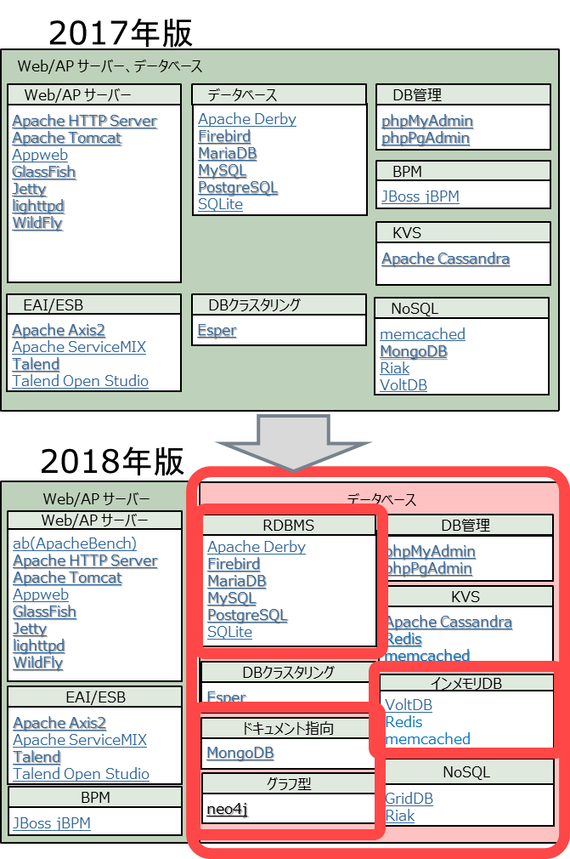
2018 to 2019 OSS bird's-eye view
2018: Database Space Independence and Updates
Separate Categories into "Web/AP Server" and "Database"
Break down NoSQL-like Categories
OSS review: Berkeley DB (database RDBMS) added, pgAdmin (database RDBMS) added DB Admin) removed, phpPgAdmin (database DB Admin) removed
2019: "IoT" and "blockchain" as new areas expand and penetrate New categories of, OSS added
IoT (add categories): Espruino, KNIME, Node-RED added
Blockchain (add categories): Bitcoin, Ethereum, Hyperledger fabric added
2019 version
IoT
Blockchain
Espruino
KNIME
Node-RED (JP)
BitCoin (JP)
Ethereum
Hyperledger fabric

Slide 35
2018 to 2019 OSS bird's-eye view
2019: Revised and updated with high importance due to "security" concerns
Added segmentation (addition) of security categories and OSS (Add 8, Remove 5)
Remove
Apache Directory server, OpenDJ (Security Directory Service), Appamor, OpenAM (Security, Authentication and Access Management), OpenIDM (Security and Identity Management)
Add
Security Antivirus/Vulnerability Management: Metasploit Community Edition Added
Security Patch/Authentication/Access Management: Istio, Notary, SMACK Added
Security Patch/Content Management (Category Added): kattello, Spacewalk Added
Security Reverse Engineering (category added): radare added
Security Network Security Monitoring (category added): Bro
OSS count
2017: 290
2019: 360(+70)
2018 to 2019 retrospective points:
More of these OSS are added as the DevOps space becomes more active and AI adoption increases in the enterprise
The rise of OSS in advanced areas such as IoT and blockchain
WG's interest in security grows in wake of ransomware epidemic - > Reflect on bird's-eye view

Slide 36
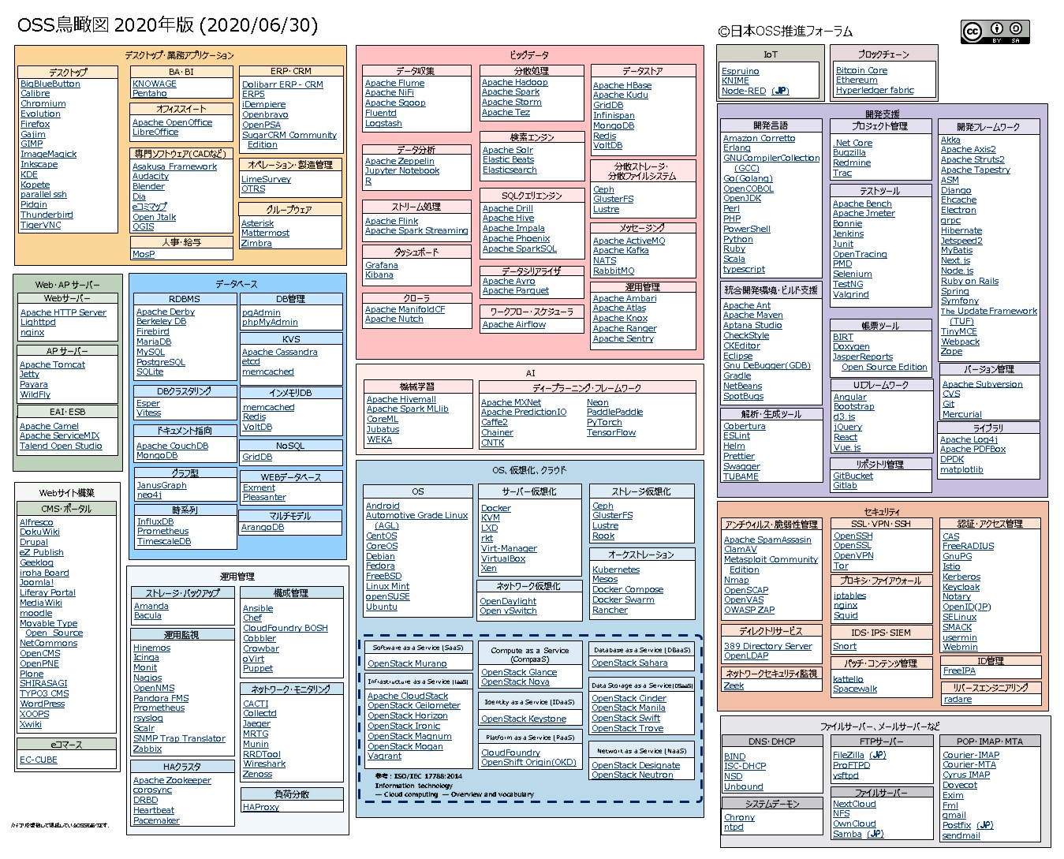

Slide 37
① Database Updates
② OS, Virtualization, Cloud Updates

Slide 38
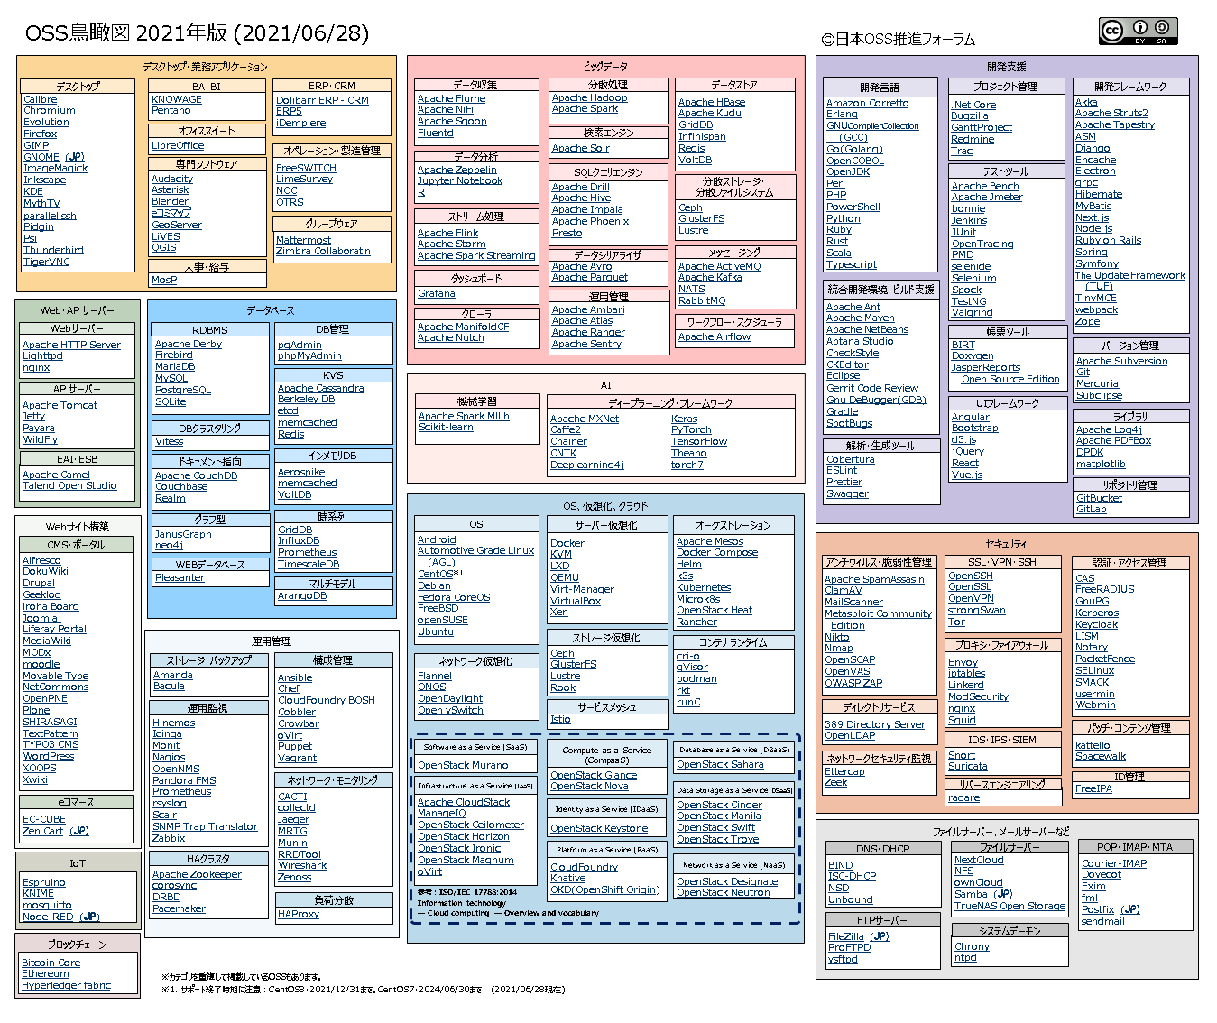

Slide 39
③ Review of AI domain
② OS, virtualization, cloud updates

Slide 40
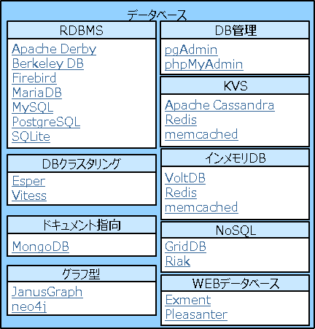
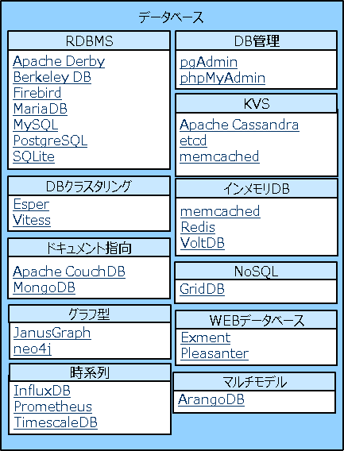
OSS bird's-eye view for 2020 to 2021
With the increased activity of big data, the corresponding database has been enhanced.
New subcategories "Time Series" and "Multi-Model" added by OSS
2019
2020
2021
Database
RDBMS
DB management
Apache Derby
Firebird
MariaDB
MySQL
PostgreSQL
SQLite
pgAdmin
phpMyAdmin
KVS
Apache Cassandra
Berkeley DB
etcd
memcached
Redis
DB clustering
Increase
Vitess
Document oriented
In-memory DB
Apache CouchDB
Couchbase
Realm
Aerospike
memcached
VoltDB
Graph type
Time series
JanusGraph
neo4j
GridDB
InfluxDB
Prometheus
TimescaleDB
WEB database
Pleasanter
Multiple models
ArangoDB
Deleted: 2 cases (Declining activity, licensing commercialization, etc.)
2020: None
2021: Exment (web database), MongoDB (document oriented)
Added: 9 2020: Apache CouchDB (document oriented), etcd (KVS), ArangDB (multiple models), Prometheus (time series), InfluxDB (time series), TimescaleDB (time series)
2021: Aerospike (in-memory), Couchbase (document oriented), Realm (document oriented)
40

Slide 41
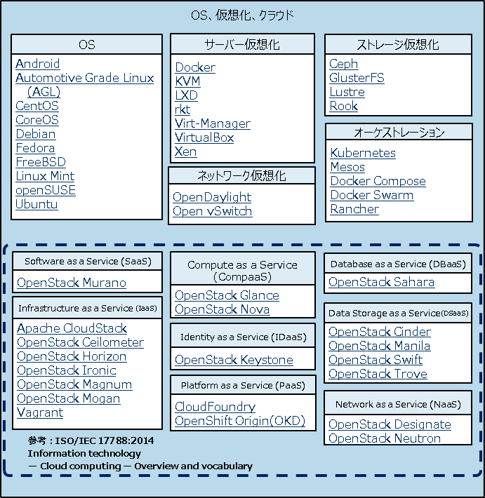
2020 to 2021 OSS bird's-eye view
The field of virtualization matures and becomes practical
Subcategories "Service Mesh" and "Container Runtime" added
2020
2021
OS, Virtualization, Cloud
OS
Server virtualization
Orchestration
Android
Automotive Grade Linux (AGL)
CentOS^{※1}
Debian
Fedora CoreOS
FreeBSD
openSUSE
Ubuntu
Docker
KVM
LXD
QEMU
Virt-Manager
VirtualBox
Xen
Apache Mesos
Docker Compose
Helm
k3s
Kubernetes
Microk8s
OpenStack Heat
Rancher
Storage virtualization
Container runtime
Increase
Network virtualization
Ceph
GlusterFS
Lustre
Rook
cri-o
gVisor
podman
rkt
runC
Flannel
ONOS
OpenDaylight
Open vSwitch
Service mesh
Istio
Deleted: 10 cases (Decreased activity, EOL, etc.)
2020: Eucalyptus(IaaS), OpenShift(PaaS), OpenVZ (server virtualization), Scientific Linux(OS), Trema (network virtualization)
2021: CoreOS(OS), FedoraOS(OS), Linux Mint (OS), OpenStack Mogan(Iaas), Docker Swarm (orchestration)
Added: 19 2020: Linux Mint (OS), Docker Swarm (orchestration), LXD (server virtualization), OKD: OpenShift Origin(PaaS), Apache Mesos (orchestration), Docker Compose (orchestration)
2021: ONOS (network virtualization), QEMU (server virtualization), oVirt(Iaas), cri-o (container runtime), runC (container runtime), gVisor (container runtime), podman (container runtime), Knative(PaaS), k3s (orchestration), Microk8 s (orchestration), OpenStack Heat (orchestration), Flannel (network virtualization), ManageIQ(Iaas), Fedora CoreOS(OS)
Software as a Service (SaaS)
Compute as a Service
(CompaaS)
Database as a Service (DBaaS)
OpenStack Murano
OpenStack Glance
OpenStack Nova
OpenStack Sahara
Infrastructure as a Service (IaaS)
Data Storage as a Service(DSaaS)
Apache CloudStack
ManageIQ
OpenStack Ceilometer OpenStack Horizon
OpenStack Ironic
OpenStack Magnum
oVirt
Identity as a Service (IDaaS)
OpenStack Cinder
OpenStack Manila
OpenStack Swift
OpenStack Trove
OpenStack Keystone
Platform as a Service (PaaS)
Network as a Service (NaaS)
CloudFoundry
Knative
OKD(OpenShift Origin)
Reference: ISO/IEC 17788:2014
Information technology
-- Cloud computing -- Overview and vocabulary
OpenStack Designate
OpenStack Neutron

Slide 42
2020 to 2021 OSS bird's-eye view
2021: Review and update OSS in the area of (Add 5, Remove 7)
OSS count
Delete
Machine learning: Apache Hivemall, CoreML, Jubatus, WEKA
Deep learning frameworks: Neon, PaddlePaddle, Apache PredictionIO
Add
Machine learning: Scikit-learn
Deeplearning framework: Deelearning4j, Theano, torch7, Keras
2019: 360
2021: 387(+27)
2020 to 2021 retrospective points:
As AI becomes more active, corresponding databases become more extensive and diverse.
More maturity in the container orchestration space.
AI adoption OSS will be centralized to scrutinize and converge OSS

Slide 44
② Review of desktop and business application areas
① Review of security areas

Slide 45
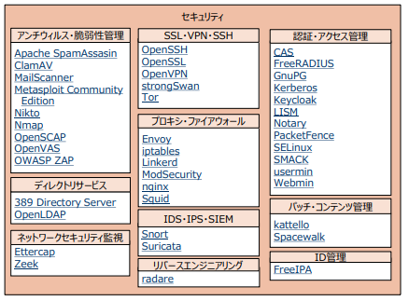
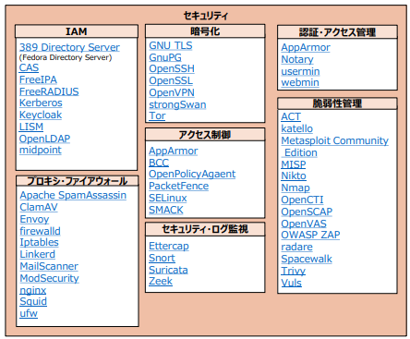
OSS bird's-eye view of 2022
Security domain: Overhauled subcategories in collaboration with OSS Security Technology Society. The importance of "IAM (Identity and Access Management)" has increased, and those that handle authentication and authorization comprehensively have been placed in the newly created subcategory "IAM."
Increase
Desktop and Business Applications area: Added subcategories such as online conferencing and multimedia
45

Slide 46

A roundup of the exciting OSS category transitions
Advanced virtualization and cloud, added many general OSS
New Big Data, revised cloud services and development support systems
Added machine learning and deep learning subcategories to Big Data
Major overhaul of DevOps, subdividing DB space
IoT, adding blockchain categories, security updates
DevOps subcategory detailing, adding orchestration to virtualization
Security subcategory overhauled, desktop cloud subcategory overhauled
Database AI area overhauled, virtualization category subdivided, new service mesh created
2012
2014
2015
2017
2018
2019
2020
2021
2022

Slide 47
Bird's eye view "Number of OSS" and "Number of categories" over time
Summary
Advanced technologies such as cloud, big data, virtualization, AI, IoT, blockchain, and ・・・ are transmitted as OSS.
As the number of OSS is increasing year by year and the categories are segmented, it is expected that there will continue to be more OSS in a wide variety of OSS, and more OSS options are being adopted. (- > OSS selection is becoming difficult)

Slide 48
(small story) OSS discussing publication
program language
packages included in Minimal install
OSS with small granularity, dependent packages
OSS provided for a fee
OSS (software) changed to proprietary license
->Publication
->Not Published
->Not Published
->Not Published
->Not Published

Slide 49
3. How to find and research OSS
Introduce sources (sites) to help you find the OSS you want to use or get information about OSS.
Some of these sites are used as references when selecting OSS for inclusion in the OSS Bird's Eye View.

Slide 50
OSS policy to post
judgment material
Github "star" number, "Fork" number
OpenHub "I Use This!" number, "Activity"
Qita Article Posts
Use these sources as a whole, rather than an absolute basis, to determine whether or not to publish. There is a slant in the number of entries for each category, so there is no threshold for the number of entries across categories.
Other Possible Judgment Criteria
Google Trends
Has not had EoL or released in the last two years?
Opinions from experts such as the Security Technology Society and the former Big Data Committee

Slide 51
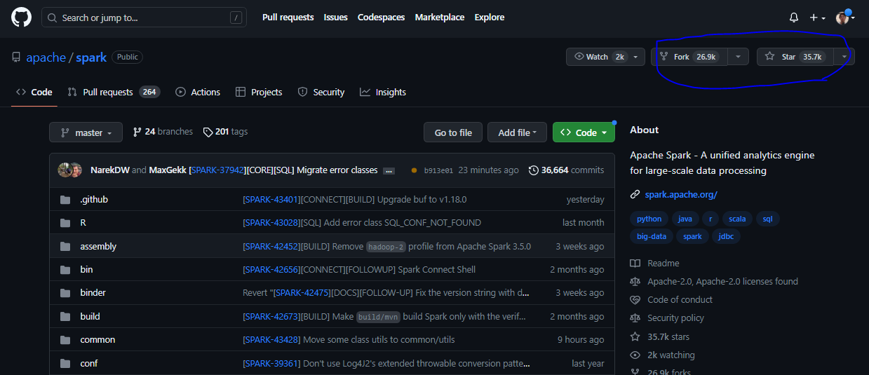
Github
Overview
Various OSS repositories
URL: https://github.com/
Number of Stars, Number of Forks

Slide 52
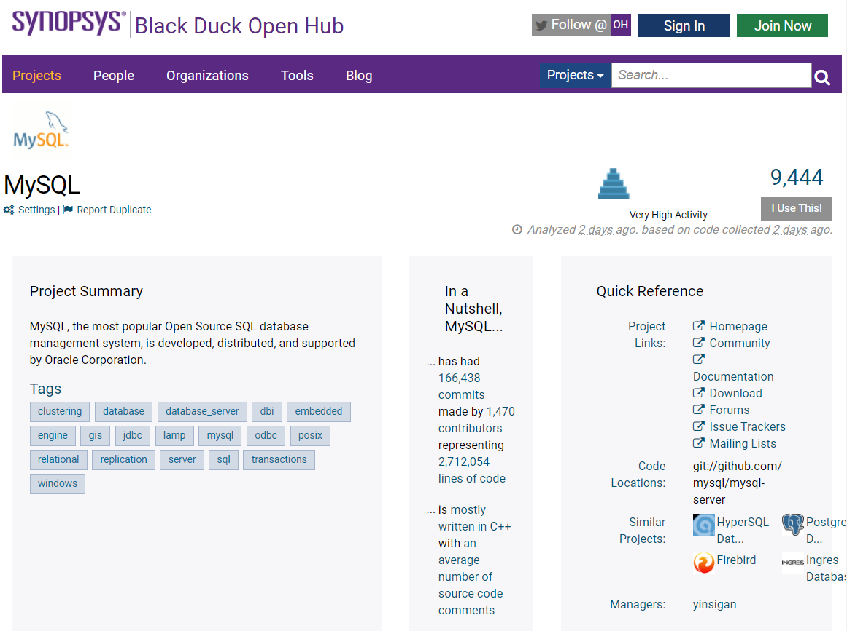
Black Duck OpenHUB
Overview
Search Sites for Various OSS
URL: https://www.openhub.net/
Various OSS Information
・Overview
・Related Technology (Tags)
・Information Site (URL)
・License
・Similar OSS
etc.

Slide 53
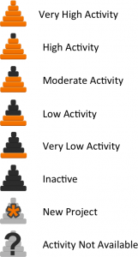
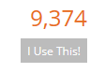
Black Duck OpenHUB
OSS activity
PAI:Project Activity Icons
I Use This !
Number of registered OpenHUB users using the corresponding OSS
Press the "I Use This" button to count
Open Hub calculates which activity icon to show based on a combination of contributor count and commit count, with more weight placed on contributors.
Activity level is relative to all projects on Open Hub

Slide 54
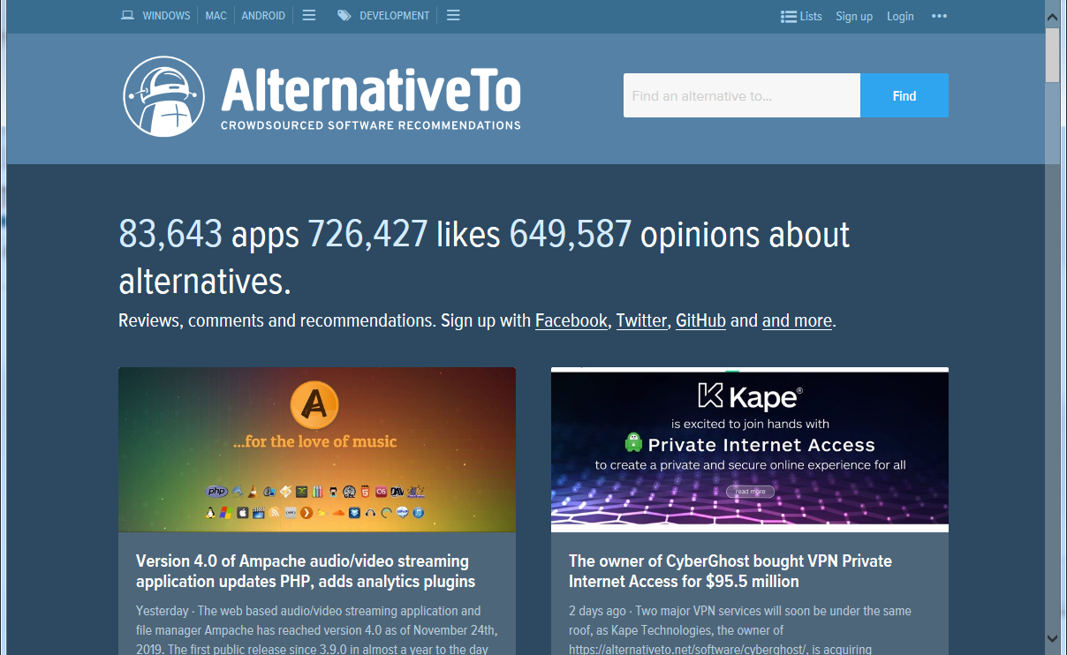
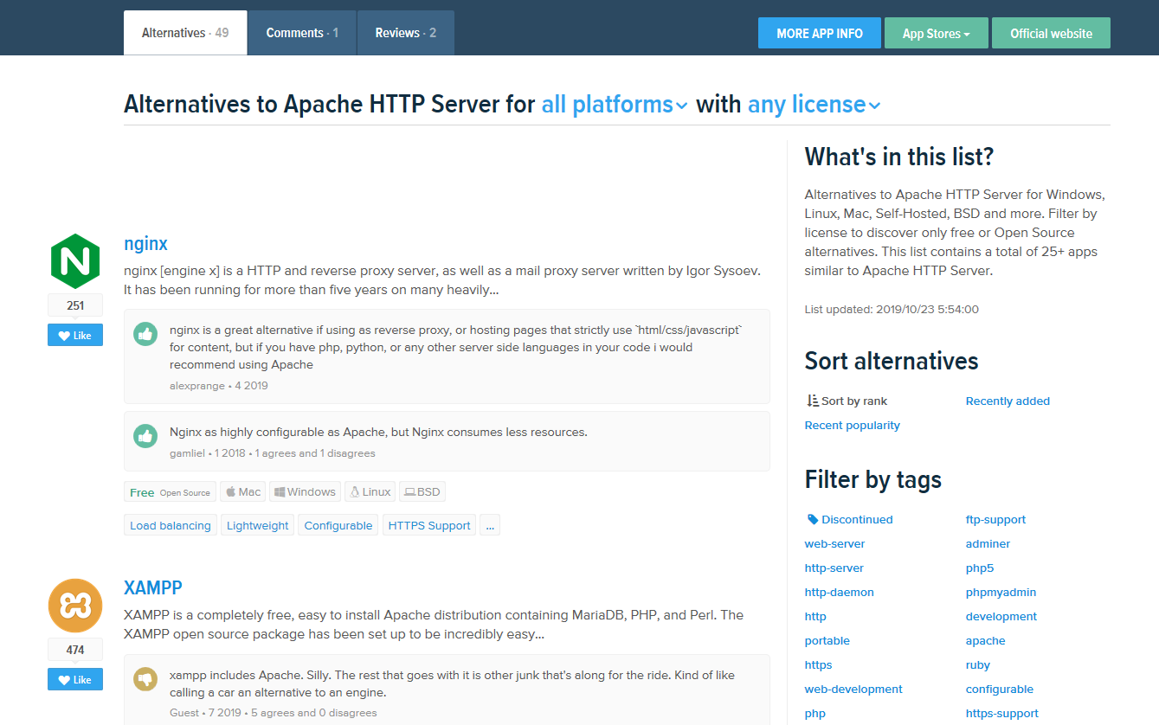
AlternativeTo
Overview
Presents OSS similar to specified OSS
URL: https://alternativeto.net/
Specify OSS
Example)Apache HTTP Server
Can be narrowed down by license type (Commercial, Free, Open Source)
Listing Apache-like OSS (web servers)

Slide 55
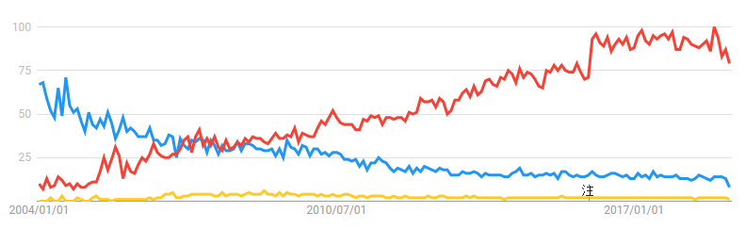
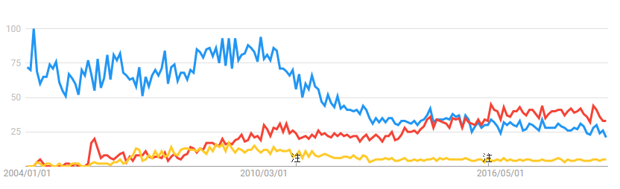
Google Trends
Overview
Check search trends worldwide
URL https://www.google.co.jp/trends
Compare Multiple Searches (OSS) = > Transition of Attention in Time Series
All Countries
Example)Operational Monitoring Tools
・Zabbix (Red)
・Hinemos (Yellow)
・JP1 (Blue)
*Can be narrowed down to world or domestic
Domestic Japan

Slide 56
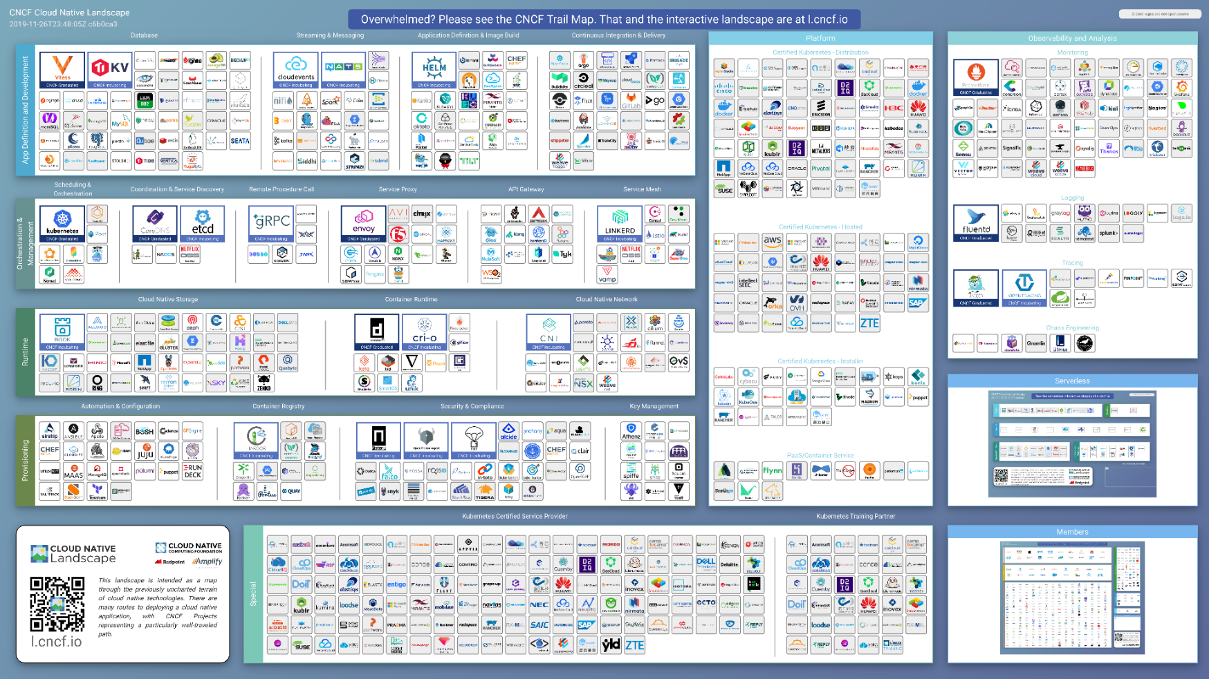
CNCF Cloud Native Interactive Landscape
Overview
List of recommended cloud-native tools
Provided by the Cloud Native Computing Foundation (CNCF)
Not limited to OSS, but includes commercial products
URL https://landscape.cncf.io/

Slide 57
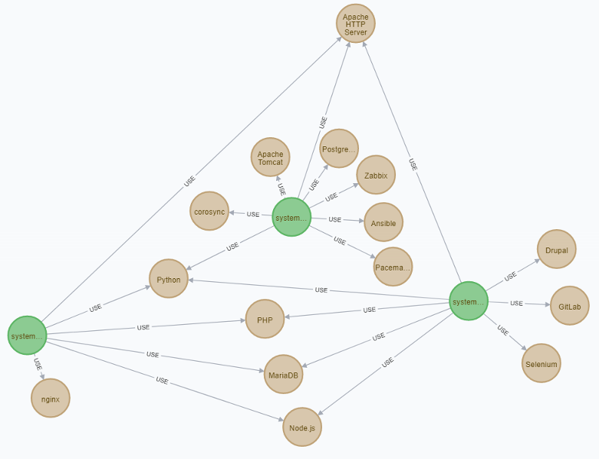
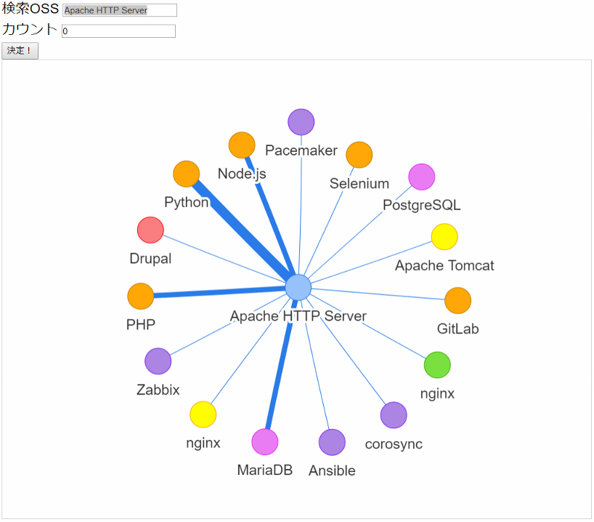

Future activities of the bird's-eye view WG
OSS bird's-eye view
Category update
Add or remove OSS
Derived OSS bird's-eye view
Examining what it should be
Mock-making
2023 OSS bird's-eye view
Update
A bird's-eye view of the derivative OSS
2022 OSS bird's-eye view
OSS questionnaire collection and opening
Github launch in June 2022
A mechanism to receive feedback for better use of bird's-eye view will continue to be considered
Promotion
Seminars in each community

Slide 58
Future activities of the bird's-eye view WG
OSS bird's-eye view
Category update
Add or remove OSS
Derived OSS bird's-eye view
Examining what it should be
Mock-making
2023 OSS bird's-eye view
Update
A bird's-eye view of the derivative OSS
2022 OSS bird's-eye view
OSS questionnaire collection and opening
Github launch in June 2022
A mechanism to receive feedback for better use of bird's-eye view will continue to be considered
Promotion
Seminars in each community

Slide 59
Finally,
use the OSS Bird's Eye View not only to select a safe, secure and stable OSS, but also to capture the latest IT technologies and trends in the world.
If you are interested in activities, please contact us!
We're looking for feedback on OSS bird's-eye view in MS Forms! → https://forms.office.com/r/E2n5084QL8
*Anonymous answers allowed
About this material: t-yoneshima@nec.com
Repository: https://github.com/ossforumjp/oss-choukanzu

Slide 60


